Slide 1





Visiting Australian Parliament House
A sensory story

Slide 2
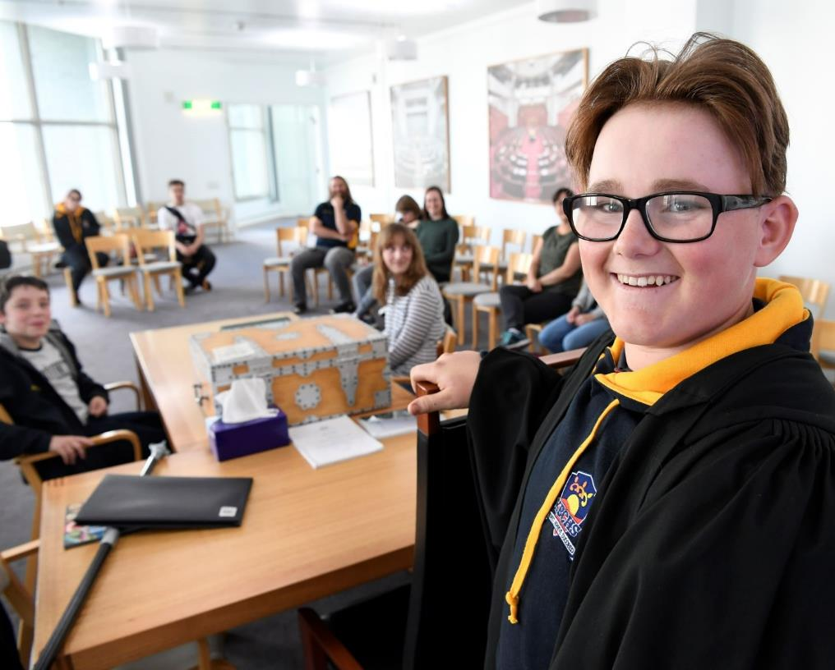
Welcome to
Parliament House!
A trip to Parliament House is an exciting and stimulating experience for all students. Use this sensory story to help your students understand what they will see and do on their visit, and what behaviour will be expected from them.
This sensory story can be tailored to meet the needs of your students. Add or remove text, and rearrange the slides to reflect your booking:
White – experiences all groups will have at Parliament House and Hospitality
Blue – tour of Parliament House
Aqua – PEO role-play program

Slide 3
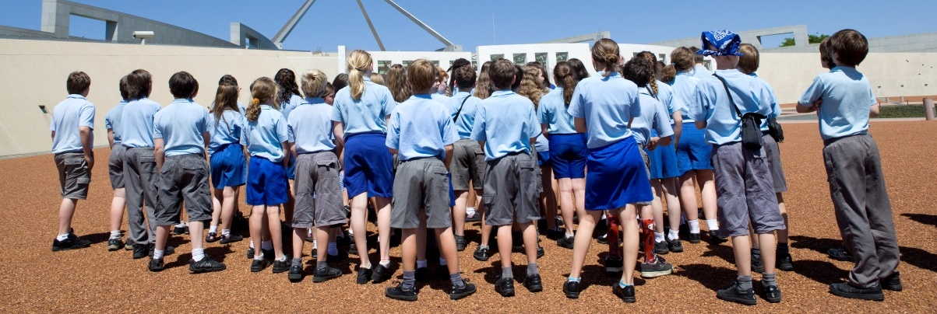
Arriving at Parliament House
Parliament House is a big, important building. It can seem a little scary but I am welcome here.
My class may have to wait outside before we go in. That’s okay because I can talk to my friends or look at the building and people around me.
There may be other schools and adults waiting to go into the building.
It is ok if I ask my teacher if I can stand away from all the people.
I might see police officers. They are here to protect me and everyone else coming to Parliament House.

Slide 4
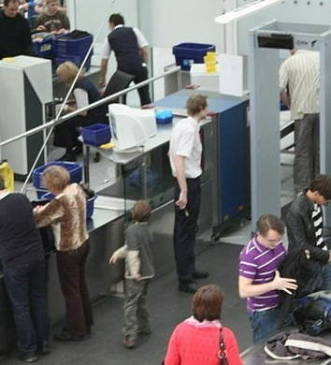
Passing through security
My class will line up and wait our turn to go through the security screening one at a time. If I have a bag or anything metal like a camera, belt or puffer, I will need to put it in a white tray to go through the scanner. I will get it back on the other side of the scanner.
Security officers wearing uniforms will be there. They know what to do and will help me with what I need to do. I will follow the directions of the security officers.
It might be noisy in this space. The machines beep all the time! This is okay.
Note: this is not a picture of the security screening at Parliament House. The machines and what people are doing in the picture are similar to Parliament House.

Slide 5
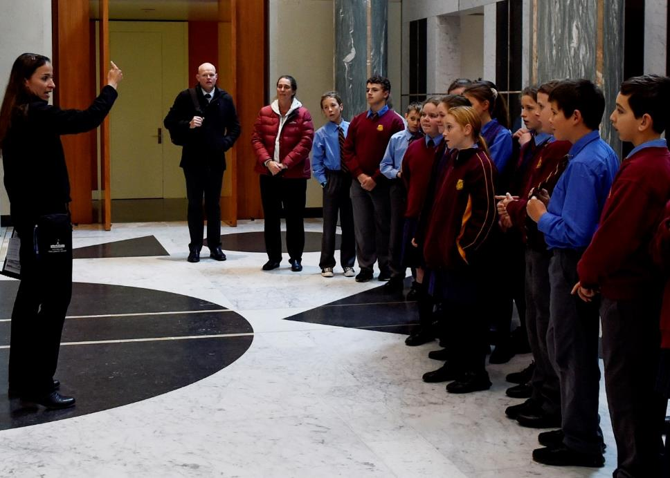
Keeping us healthy
To help keep everyone at Parliament House healthy, I will sanitise my hands. My class will be told how we can help keep ourselves and everyone else in Parliament House safe.

Slide 6
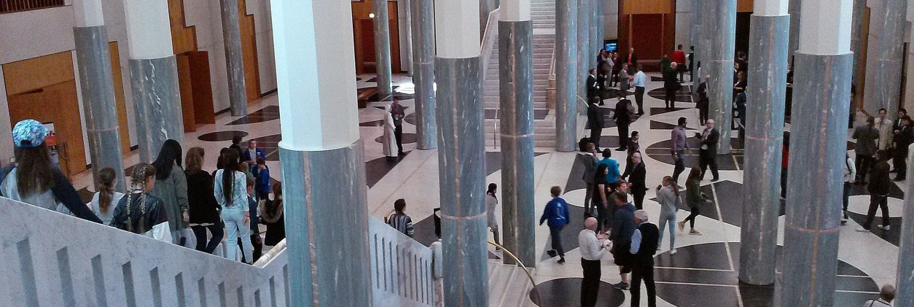
Waiting in the Marble Foyer
The Marble Foyer is very big, with high ceilings and a shiny floor. I will see lots of different people and other school groups here. Loud noises echo in the Foyer and it can be noisy. I will try to use my indoor voice.
My class may need to wait. I will stay with my teacher and my class. My teacher knows what we are going to do and when.

Slide 7

Ringing bells
When I am in Parliament House, I might hear bells ringing, and see red and green lights flashing on the clocks. The bells usually ring for 4 minutes, which can seem like a long time!

Slide 8
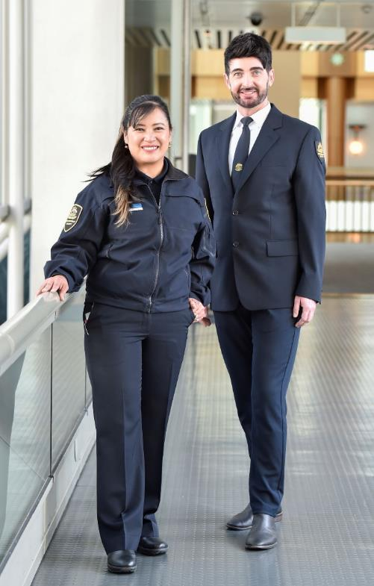
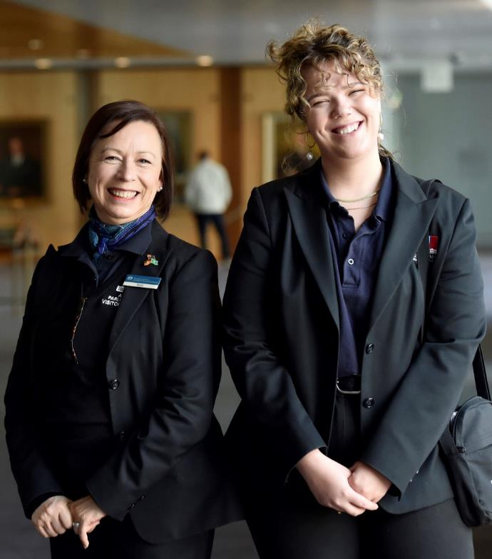
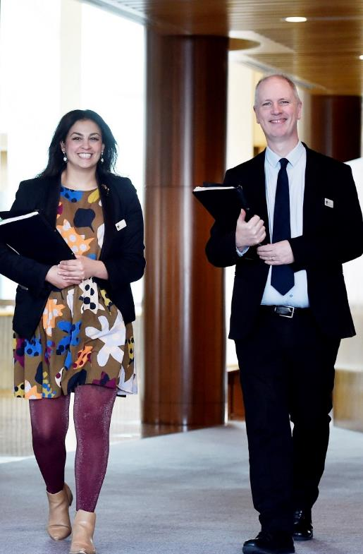
Who can I ask for help?
Security officer. I can recognise them because they wear official uniforms and sometimes have a radio.
Tour guide. I can recognise them because they wear a blue shirt, blue scarf or tie and a blue name badge.
PEO Educator. I can recognise them because they wear a name badge with Parliament House on it.

Slide 9
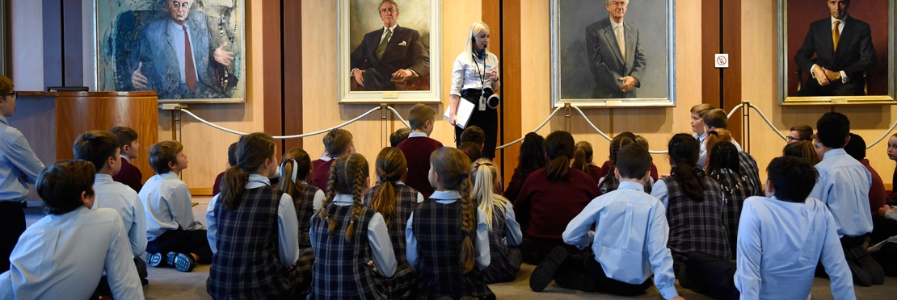
Parliament House Tour
My class will meet our friendly guide, who will take us on a tour of Parliament House. This will be fun. They will ask us to sit or stand so they can tell us their name. I need to listen to the guide because they will have important information about what we are going to do. The guide will tell us that we must stay together on our tour. It might be loud in the space but I can stand near the guide so I can hear.
Our tour will take up to 1 hour.
Meeting our tour guide

Slide 10
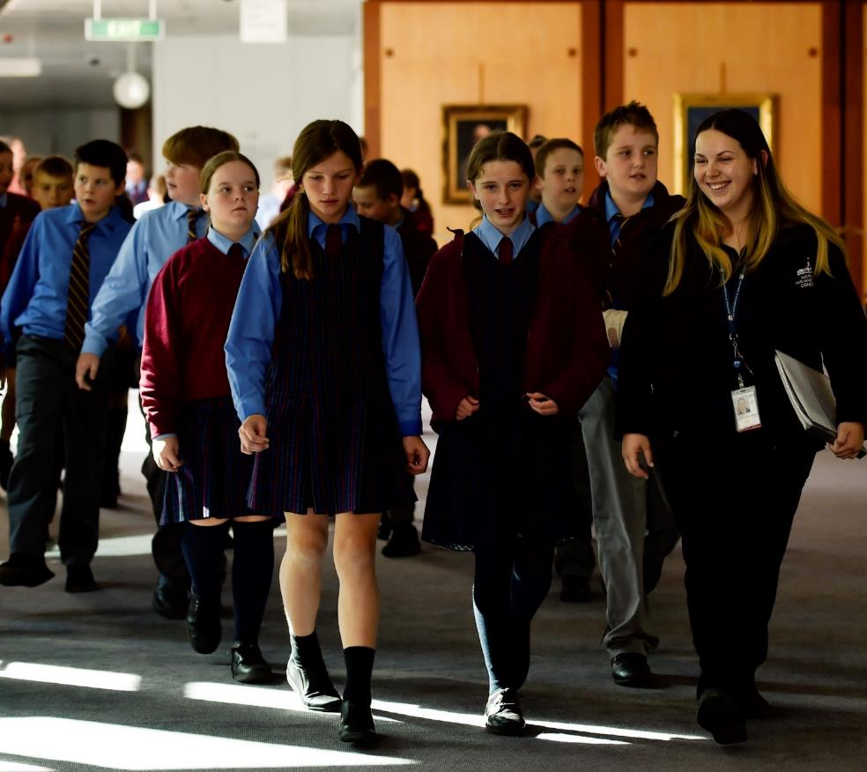
Parliament House Tour
Moving around the building
Parliament House is big building and we will have to walk to different places. Our tour guide may ask my class to walk in 2 lines. There maybe lots of other people in the building.
If I need to go to the bathroom, I will speak to my teacher. I may not be able to go straight away, so I will need to be prepared.

Slide 11
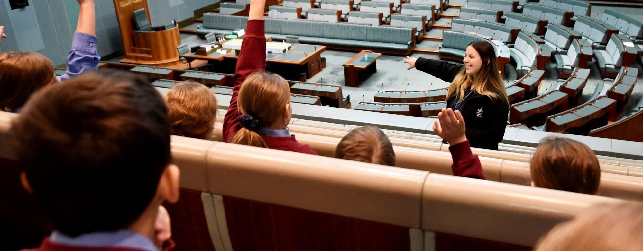
Parliament House Tour
The House of Representatives is a very big room, with lots of chairs and a big skylight. It is very green! There may be other school groups and visitors in the other chairs across the room, so I will try to use my indoor voice. Our guide will tell us all about the room and what it is used for. I will sit in my chair and listen. I will put up my hand if I have a question.
The House of Representatives

Slide 12
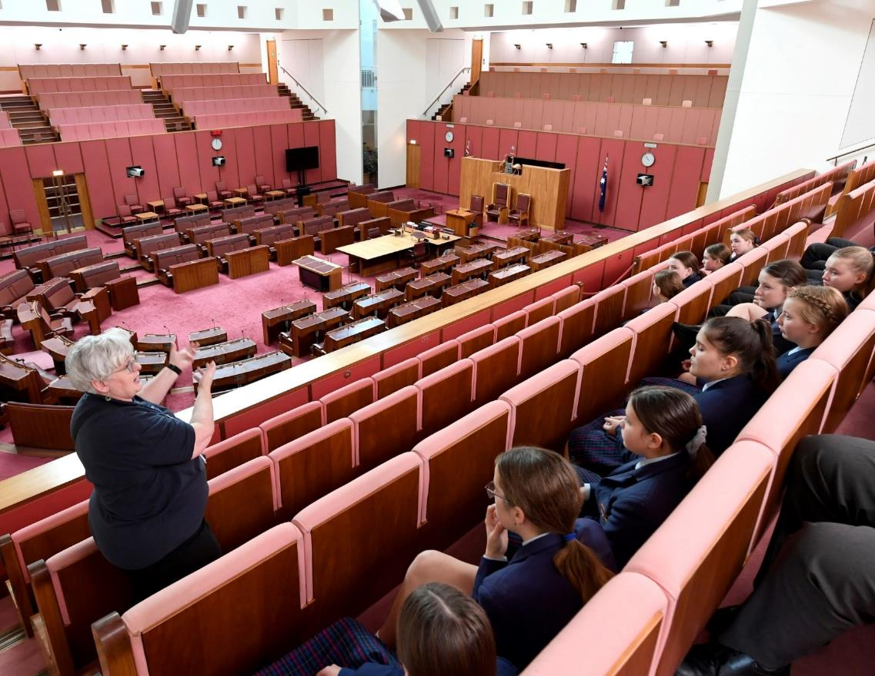
Parliament House Tour
The Senate
The Senate is also a very big room! It is red, and there are lots of chairs in a horseshoe shape. There may be other school groups and visitors in the other chairs across the room. I will try to use my indoor voice. Our guide will tell us about what happens in the Senate. I will sit in my chair and listen. I will put up my hand if I have a question.

Slide 13
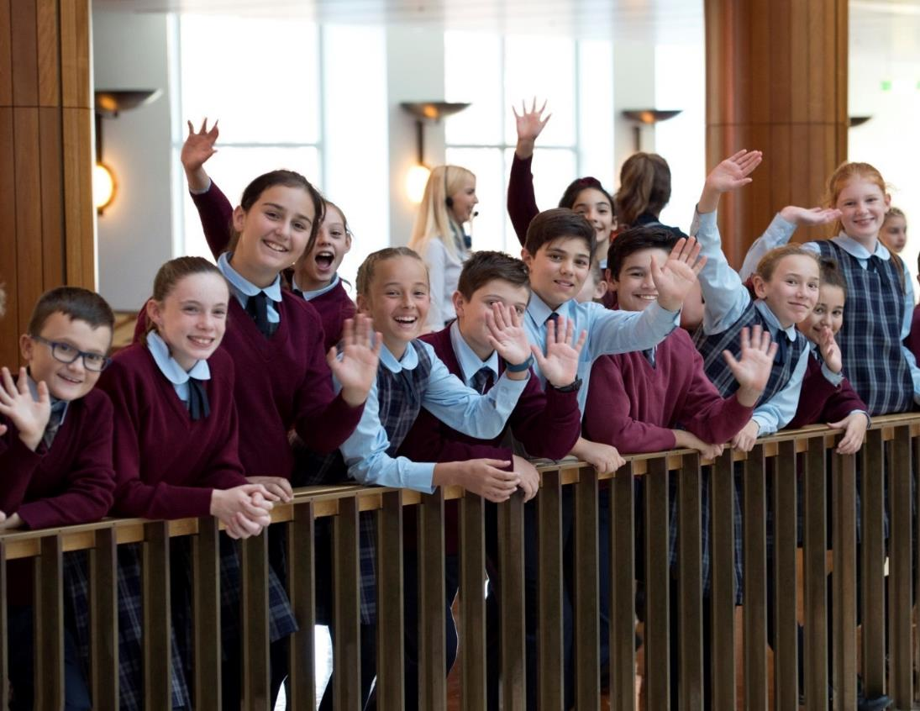
Parliament House Tour
End of tour
At the end of the tour, I will say goodbye to our guide.

Slide 14
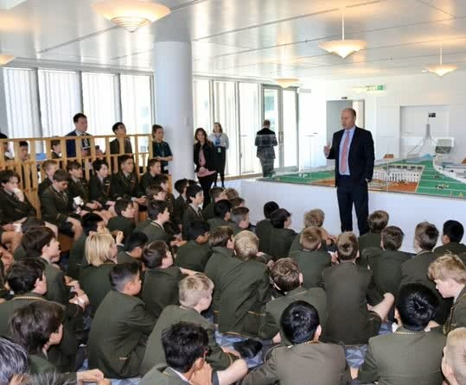
Hospitality
My class will have time to rest while at Parliament House. We will be given a snack and a drink. It’s ok if I don’t like the snack. I can let my teacher know if I don’t like it. I can sit down and talk to my friends.
There may be other school groups in the room. If it is too loud for me, I can ask my teacher if I can go somewhere quieter.

Slide 15
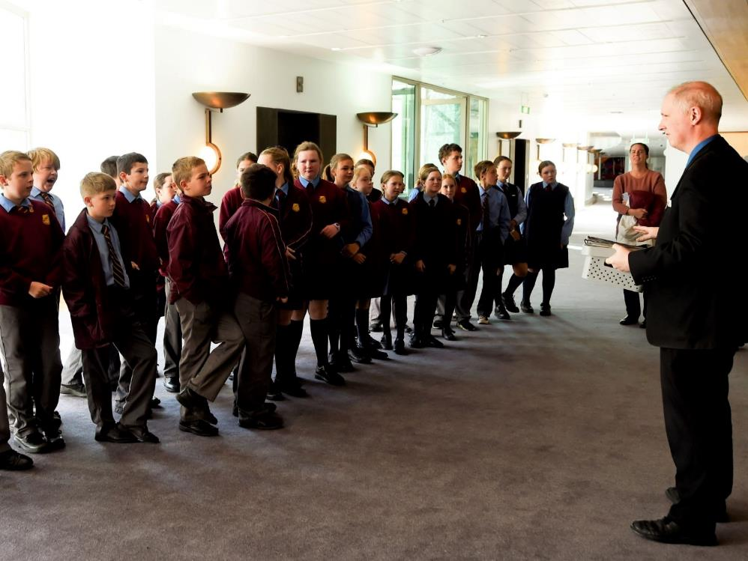
PEO role-play program
Meeting our PEO Educator
My class will meet a friendly PEO Educator who will be doing a fun role-play program with us. They will ask my class to sit or stand so they can introduce themselves. I need to listen to the PEO Educator because they will have important information about what we are going to do. It might be loud in the space but I can stand near the PEO Educator so I can hear.
We will need to go to another room and we will be there for up to 1 hour.

Slide 16
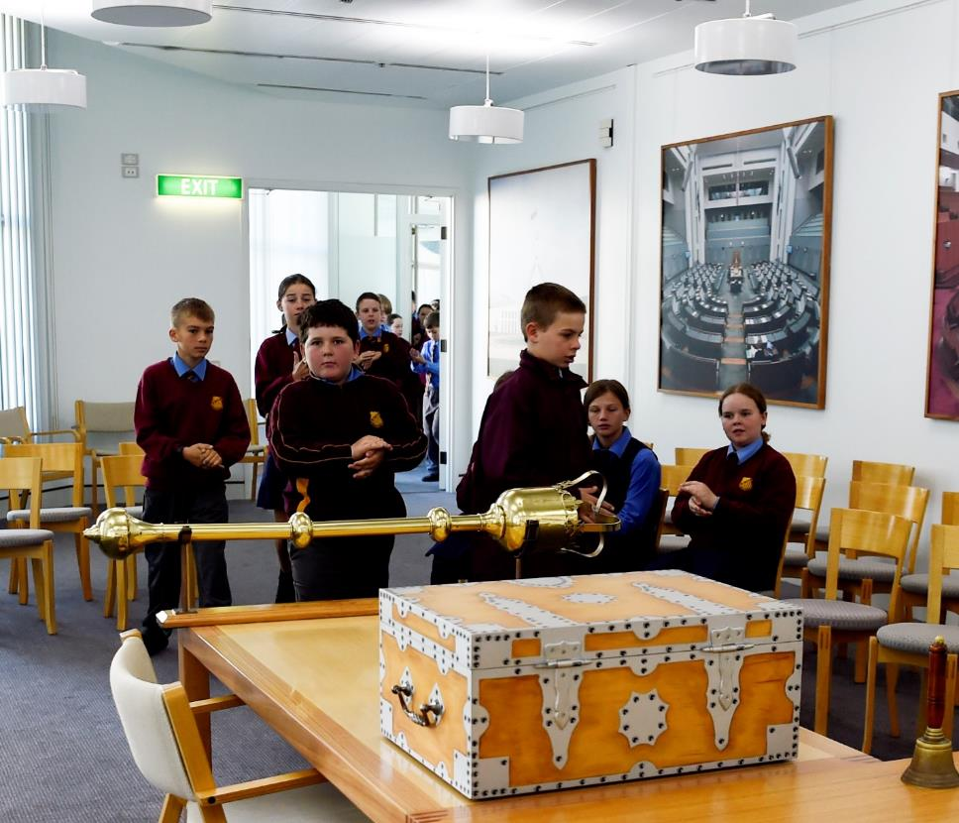
PEO role-play program
Entering the room
When my class enters the room we will be doing our role-play in, I will quietly and quickly choose a seat.
There are lots of exciting things to look at and to touch. I can ask the PEO Educator if I can have a closer look.
If I need to go to the bathroom or leave the room, I will speak to my teacher. I may not be able to leave the room straight away, so I will need to be prepared.

Slide 17
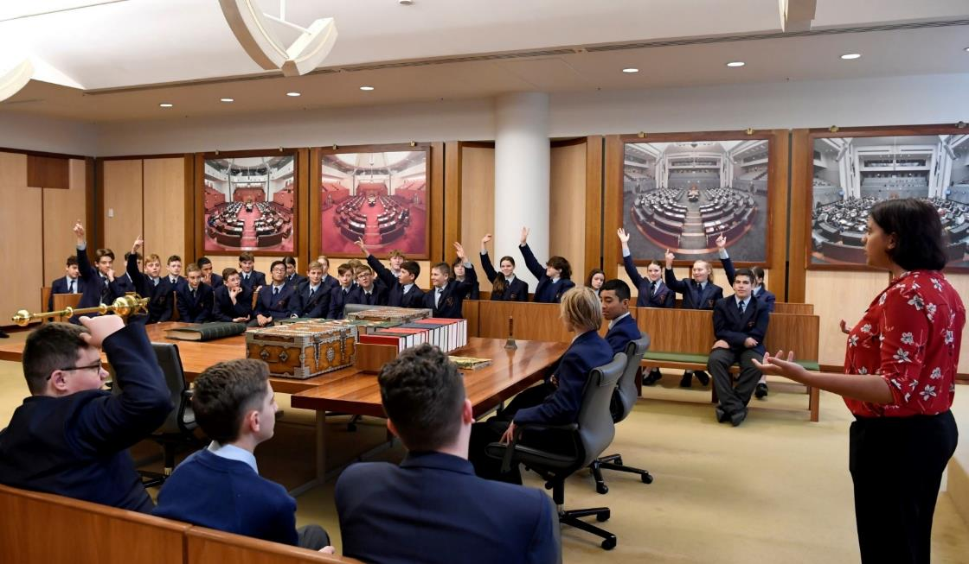
PEO role-play program
Starting the role-play
Before we start the role-play, the PEO Educator will explain what is going to happen so we will know what to do. Some students will be chosen for roles and will get to wear costumes. If I am not chosen, that is okay. I do not have to do anything that makes me feel uncomfortable.
The PEO Educator will ask lots of questions. I can put my hand up if I have an answer to a question or if I want to ask my own question. I will not interrupt the person speaking.

Slide 18
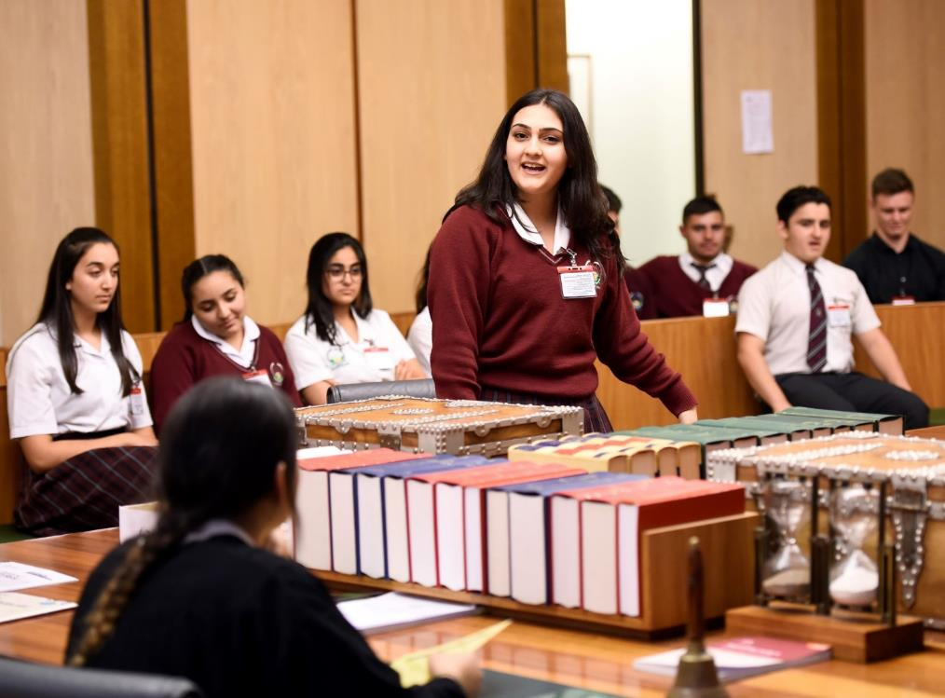
PEO role-play program
Role-play: the debate
Some people in my class will be asked to read speeches, then everyone will get an opportunity to give their own speeches. I don’t have to give a speech if I don’t want to.
I will respect my classmates by quietly listening to their speeches.

Slide 19
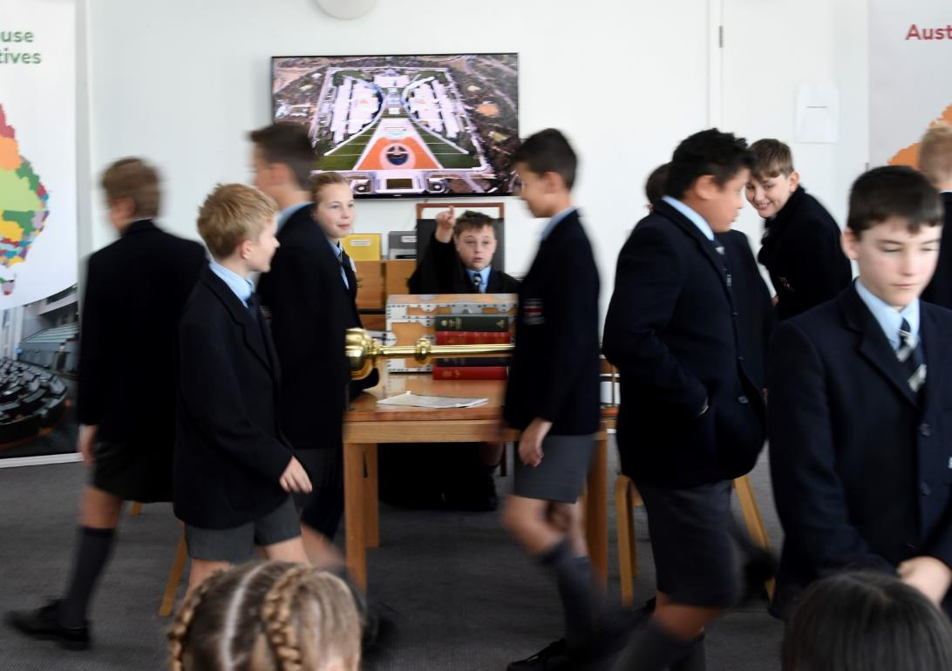
PEO role-play program
The vote
After the speeches are finished, we will be asked to vote. My classmates and I will shout ‘aye’ and ‘no’. This may be loud. Maybe we will need to take another vote. I may be asked to go and sit on the other side of the room with my team.

Slide 20
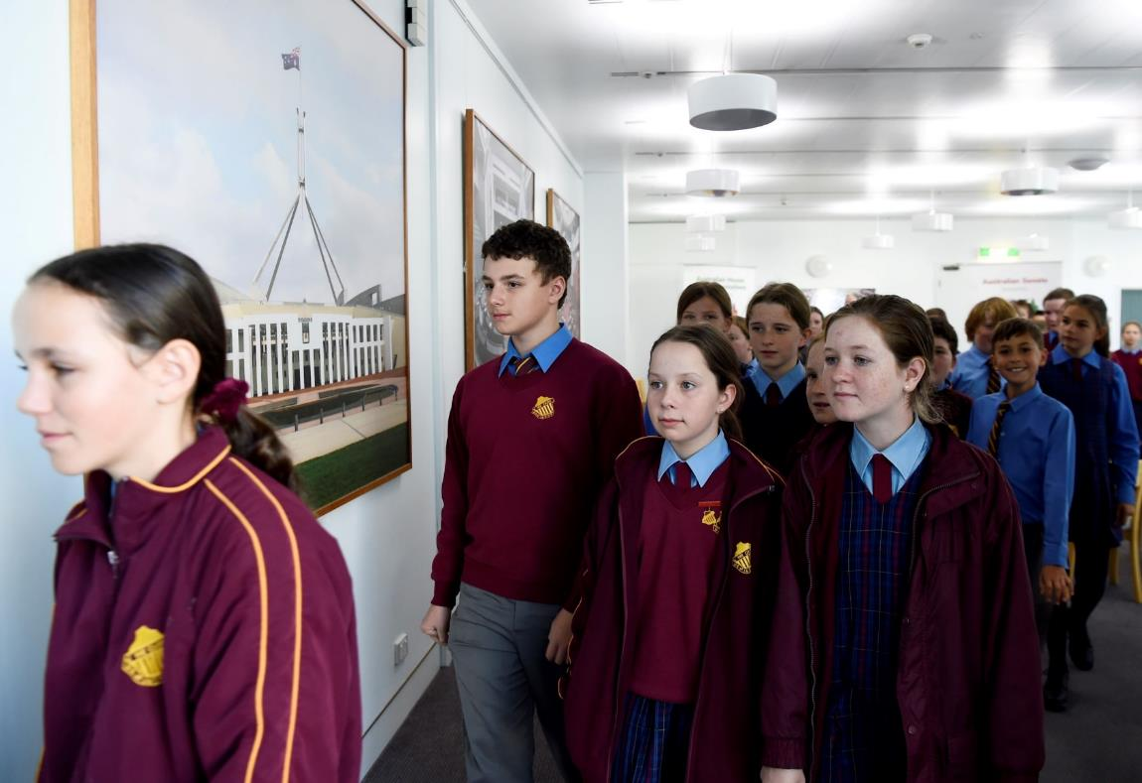
PEO role-play program
Leaving the room
When we are asked to leave the room, I will check I haven’t left anything behind and go to the door. I will leave the room quietly and stay with my class.
As I leave the room it will go from quiet to noisy again. I will say goodbye to the PEO Educator.

Slide 21
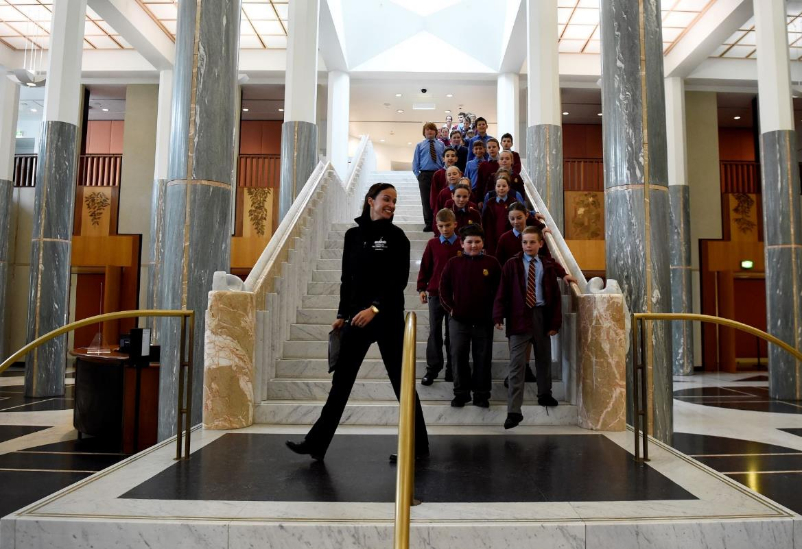
After we have done all the things my teacher has planned, we will return to the Marble Foyer and then leave Parliament House.
Finishing at Parliament House

Slide 22
peo.gov.au

