Slide 1

Teacher Professional Learning
OUR DEMOCRACY

Slide 2
MODULE 1
Democracy

Slide 3
In this module you will learn that:
Australia is a constitutional monarchy and a representative democracy.

Slide 4
What is a democracy?
What democratic values are important to you?
Democracy fact sheet

Slide 5
What is democracy?
Put simply, democracy is a system of government where rule is by the people.
Democracy can be defined as a society in which the citizens are sovereign and control the government.
There are many different types of democracy through the world, but Australia is both a representative democracy and a constitutional monarchy. This means eligible citizens elect candidates to carry out the business of governing on their behalf.
Our system of government draws on many of the traditions and practices of both the British and the United States systems of government.
Representative democracy:
a system in which people vote for candidates to represent them in a parliament and make laws on their behalf.
Constitutional monarchy:
a system of governance in which a king or queen is the head of state, but acts in accordance with a constitution and accepted practices known as conventions.

Slide 6
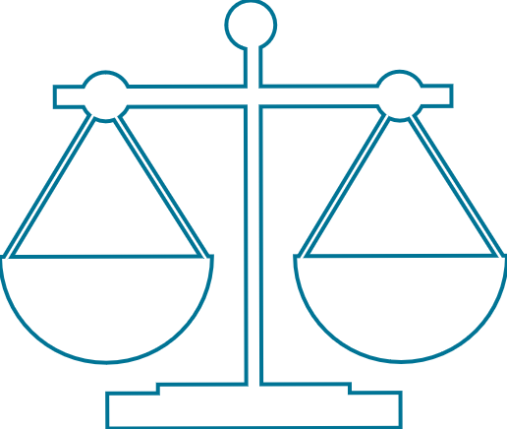
What is the rule of law?
The rule of law is one of the key ideas underpinning most democracies.
It is the concept that both the government and the citizens know the law and are subject to it.

Slide 7

What are the key values of Australian democracy?
Australian democracy has the following core defining values:
a rule of law for both citizens and the government
free and franchised elections
an inclusive and equitable society
an active and engaged citizenry.

Slide 8


ACTIVITY
Brainstorm a list of freedoms you think are important in your community.
Write your responses on post-it notes (one idea per note). Place notes in no particular arrangement on a wall or whiteboard.
Once lots of ideas have been generated, begin grouping them into similar categories. Label the categories and discuss why the ideas fit within them, how the categories relate to one another, and so on.
Suggested categorisations
  A scale from most important to least important
  Grouped according to the four key values of Australian democracy (listed above)

Slide 9

Food for thought
What democratic values are important to you?
Have you ever experienced living under a different system of government?
Is democracy best for everyone? Why or why not?
What’s more important – majority rule or individual freedom? Why?
Why is the media important in a democracy?
Who is responsible for Australia’s democracy? How are they responsible?
Is it fair for the law to treat everyone exactly the same?

Slide 10
Additional resources
Classroom activity – Unpack democracy
Museum of Australian Democracy – Democracy

Slide 11
MODULE 2
Federation

Slide 12
In this module you will learn that:
Federation was a key moment in Australia’s nationhood.
The decisions made at the time of federation affect the way our country runs today.

Slide 13
Why and how did Australia federate?
What results of federation can we see in our current system of government and why is this significant?
Federation – video

Slide 14
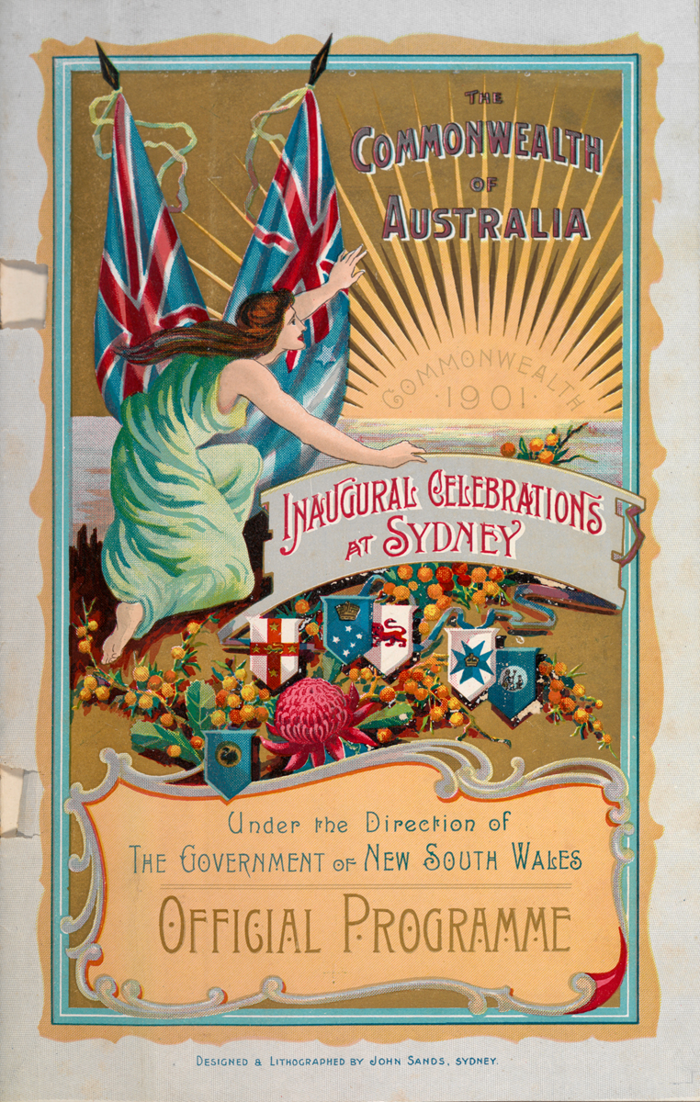
Why and how Australia federated
Background
For at least 50 000 years, Indigenous people have lived on the Australian continent and practised traditional cultures, languages and systems of government.
From the late 1700s British colonies were founded in Australia. In 1901, these colonies (New South Wales, Victoria, Queensland, South Australia, Western Australia and Tasmania) came together and formed the nation of Australia through a process known as federation.
Before 1901 Australia did not exist as a nation. The six British colonies were like six separate countries. Each colony had a parliament that could make laws, but was still subject to the authority of the British Parliament.

Slide 15
The path to federation
Popular support for federation grew in the 1880s and 1890s as people realised the colonies would be stronger and more efficient if they united. It was felt a national government was needed to deal with issues such as trade, foreign policy, immigration and defence.
Although most colonists were of British descent and looked to Britain as the 'mother country', they had started to see themselves as belonging to one separate nation.
In order to federate the colonies would have to surrender some of their powers to a new national government.
The colonies decided they needed a set of rules, or constitution, to set out how Australia should be run, including how the power to govern should be divided.
The Australian Constitution was written at a series of conventions (meetings) attended by representatives from the colonies.
The Constitution was then approved in referendums (a vote of the people) held in each colony between June 1899 and July 1900.
The Commonwealth of Australia Constitution Act was passed by the British Parliament in July 1900. It allowed the six colonies to become Australian states and created the federal, or Commonwealth, Parliament.

Slide 16
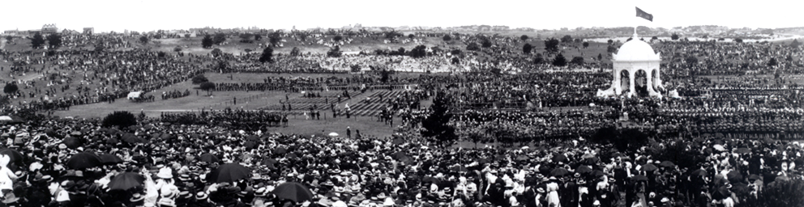
Constitutional monarchy
The King (represented by the Governor-General) is our head of state and retains some powers which are described and limited by the Constitution and by accepted practices known as conventions.
These powers, exercised by the Governor-General on the advice of the Prime Minister include signing bills into law, calling elections, appointing ministers, and declaring war.
The UK doesn’t have a single written constitution; instead it considers conventions and a number of texts—including the Magna Carta—to serve as a constitution.
We can change our Constitution through a referendum, which requires a double majority to pass.

Slide 17
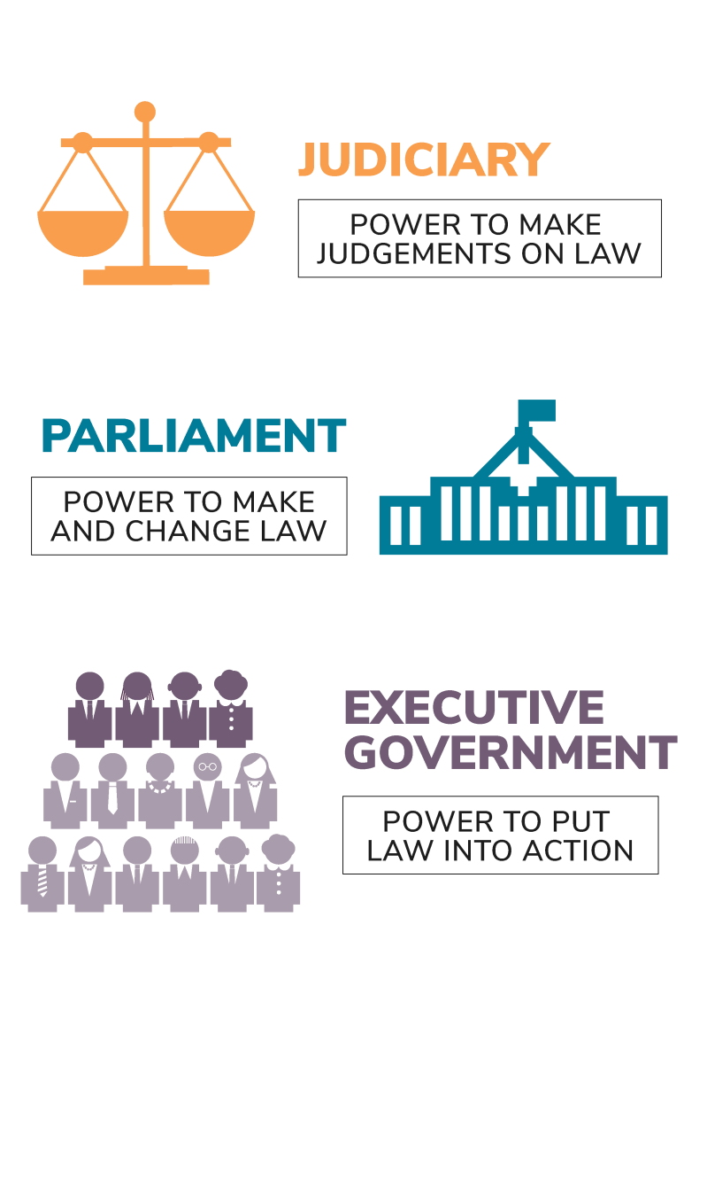
Separation of powers
The separation of powers is the principle that the power to govern should be distributed between the Parliament that makes the law, the Executive that puts the law into action and the Judiciary that interprets the law.
The separation of powers works together with another principle known as responsible government, to guide the way law is made and managed. Responsible government means that a party, or coalition of parties, must maintain the support of the majority of members of the House of Representatives in order to remain in government. This provides another check on the Executive, ensuring they remain accountable to the Parliament and do not abuse their power.
Australia does not have a complete separation of powers because some of the roles of the Parliament, the Executive and the Judiciary overlap. For example, the Prime Minister and ministers are part of the Executive and the Parliament. High Court judges, the Prime Minister and ministers are officially appointed by the Governor-General, who is part of the Parliament and the Executive.

Slide 18

Bicameralism
Our Parliament is based partly on the English Westminster system and partly on the American Congress so it is sometimes referred to as a Washminster parliament.
Our House of Representatives is similar to the UK House of Commons and the American House of Representatives in that representation is based on population. This results in more representatives—and more legislative power—for the states with large populations. In order to balance this, the Constitution establishes a Senate—based on the American Senate—in which each state is represented equally.

Slide 19
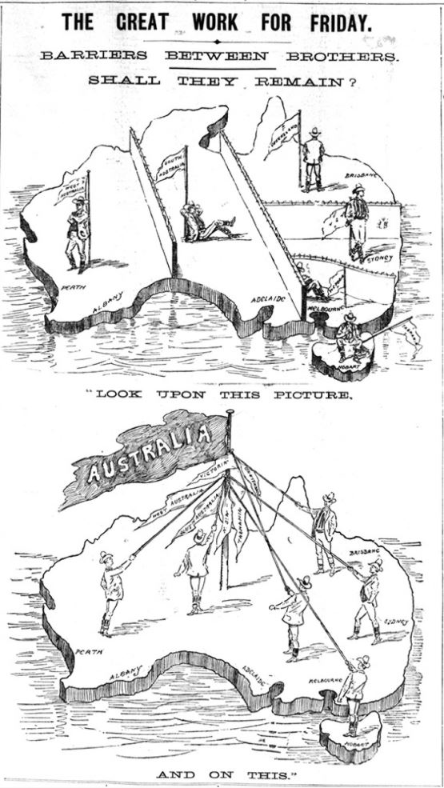
ACTIVITY
Annotate the 1898 Argus illustration ‘The Great Work for Friday’ with facts you know about federation and questions about what you’d like to know.
Explore the additional resources at the end of this module to find answers to your questions.

Slide 20
Food for thought
Why do you think these particular issues were drivers to federate? What else was happening in the world around this time that might be related?
Why do you think it is so rare for the Australian people to agree to changes to our Constitution?
Why do you think our Parliament has two houses? Do we need both?

Slide 21
Additional resources
PEO resources
Fact sheet – Federation
Website – Federal Parliament History Timeline
Other resources
Museum of Australian Democracy – Getting it together: from colonies to federation
Australian Electoral Commission – Federation

Slide 22
MODULE 3
The Australian Constitution

Slide 23
In this module you will learn that:
The Australian Constitution is the handbook for how to run Australia.

Slide 24


Focus questions
What is the importance of the Australian Constitution?
How and why is the separation of powers included in the Constitution?
What are the components of the Australian Parliament?
Resource
Constitution – video

Slide 25
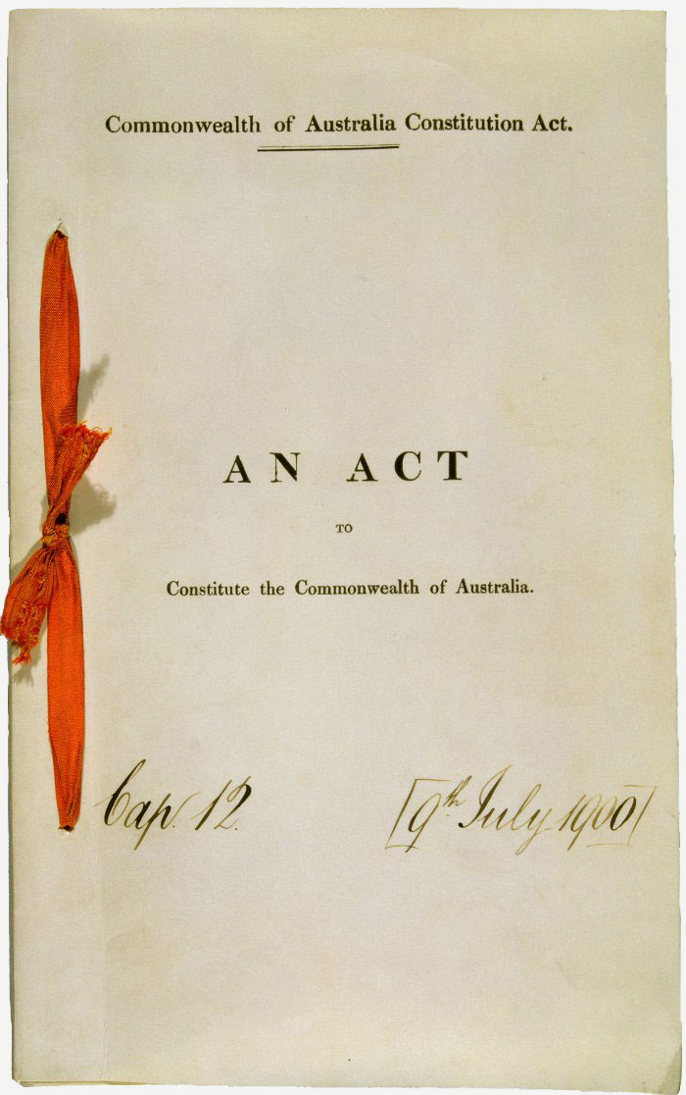
What is the Constitution?
The Constitution provides the rules for how Australia is run.
It is made up of eight chapters and 128 sections.
It united the six British colonies as separate states within the Commonwealth of Australia.
While each state kept its own parliament, the Constitution also created a Commonwealth (federal) Parliament. It describes the powers of the federal and state parliaments.

Slide 26
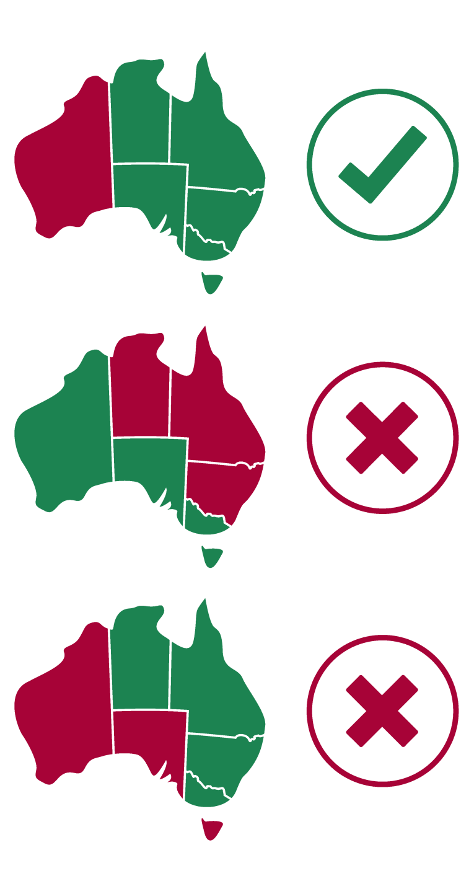
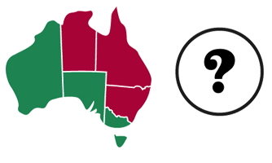
The Constitution can only be changed if the Australian people agree. A proposed change must be approved by the federal Parliament. It then has to be put to the Australian people in a special vote called a referendum, which requires approval by: a majority of voters in a majority of states (at least four of the six states) and a national majority of voters (more than half the voters in Australia must vote YES).
Territory voters are counted in the national majority.
Nineteen referendums proposing 44 changes to the Constitution have been held since federation. However, only eight changes have been agreed to by the Australian people.

Slide 27
Separation of powers
The Constitution establishes three groups – the Legislature (Parliament), the Executive (Prime Minister and Cabinet) and the Judiciary (federal courts). The power to make and manage federal law is divided, or shared, among these three groups. This division is based on the principle of the ‘separation of powers’.
It allows each group to keep a check on the actions of the others and so prevent the misuse of power.
Australia does not have a complete separation of powers because some of the roles of the Parliament and the Executive overlap. For example, the Executive is chosen from among government members of the Parliament, and members of the Judiciary (including High Court judges) are appointed by the Governor-General.
The Parliament makes and changes laws.
The Executive puts laws into action and carries out the business of government. The Constitution gives the King executive power; in reality, it is the Prime Minister and ministers who perform the work of the executive with the approval of the Governor-General.

Slide 28
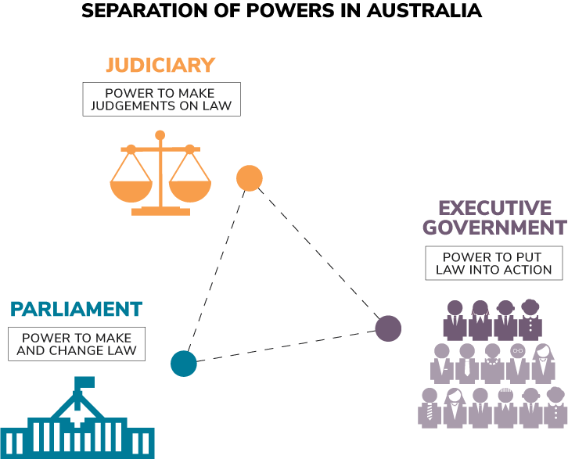
The High Court acts like an umpire. It interprets the Constitution and existing laws. It also resolves disagreements between the federal and state governments about their law-making powers. Since federation, rulings made by the High Court have strengthened the law-making role of the federal Parliament.

Slide 29
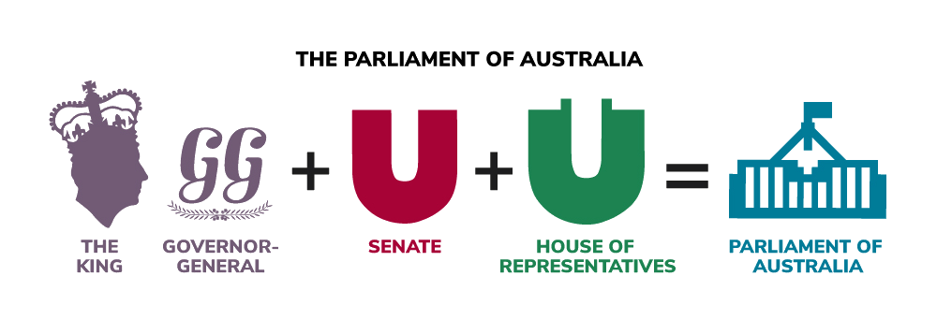
Composition of Parliament
The Australian Constitution describes three components making up the composition of the Australian Parliament:
  the Monarch as head of state, (represented in Australia by the Governor-General)
  the Senate
  the House of Representatives.
The King is represented in Australia by the Governor-General. The Governor-General performs the ceremonial functions of head of state on behalf of the King. The Governor-General exercises their power under advice from the executive government. Under the Constitution the Governor-General is commander in chief of the defence force.

Slide 30

The Constitution specifies the composition of the House of Representatives and the Senate. The two houses have similar law-making powers and laws can only be passed or changed with the approval of both houses.
The House of Representatives is based on population, with members representing electorates made up of approximately the same number of people. The Senate, or the upper house, provides all states with equal representation. Because states with greater population end up with more representation in the House of Representatives, the Senate ensures these states do not dominate the Parliament.

Slide 31
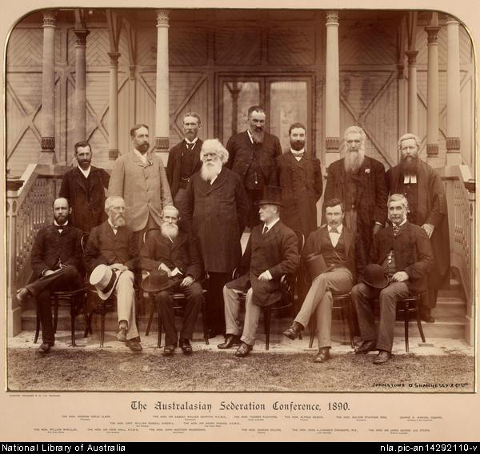
CLASS ACTIVITIES
Consider the decisions made by the drafters of the Australian Constitution. Would the same decisions be made if the Constitution were being written today?
Imagine you are writing a constitution for a new federation. Using the scaffold on the next slide, design a constitution for a new federation.

Slide 32
 | Option 1 | Option 2 | Option 3 | Create your own
Levels of government | Three levels – federal, state, and local | Two levels – federal and local | Two levels – federal and state
Head of State | Hereditary monarchy | Appointed by parliament | Elected by the people
Executive government | Appointed by the Prime Minister from among elected representatives in their party | Appointed by the Head of State, may or may not be elected representatives | Made up of the Head of State, the Prime Minister and elected representatives from across the parliament
Parliamentary structure | Bi-cameral – two chambers | Single chamber | Two chambers plus an advisory body appointed by the parliament or the head of state
Parliamentary powers | Power to make laws on a limited number of topics, with remaining issues left to the other levels of government | Power to make laws on any topic, but also to delegate power to the other levels of government | Power to allow or disallow laws made by the other levels of government
Election frequency | Elections to be held on a regular schedule | Elections to be held when decided by the head of state | Elections to be held when decided by the parliament or government
Representation | Based on population, with each representative responsible for a similar number of voters | Proportional, with each representative sharing an electorate with a number of other representatives | Based on state or local government areas, with each electorate having the same number of representatives regardless of population
Courts | Judges and justices appointed by the government or the parliament | Judges and justices appointed by the Head of State | Judges and justices elected by the people
Changing the constitution | Referendum of the people | Decision of the parliament | Decision of the Head of State

Slide 33
Additional resources
The Constitution
Fact sheet – Australian Constitution
Website – The Australian Constitution Online
In focus – The Australian Constitution
Classroom activity – Hold a referendum
Separation of powers
Fact sheet – Separation of Powers
Composition of Parliament
Fact sheets – Australian Parliament, Governor-General, House of Representatives, Senate

Slide 34
MODULE 4
Three levels of government

Slide 35
In this module you will learn that:
Three levels of government provide different services to Australians

Slide 36
Why have three levels of government?
What are the differences between the three levels of government?
Three levels of government – video

Slide 37
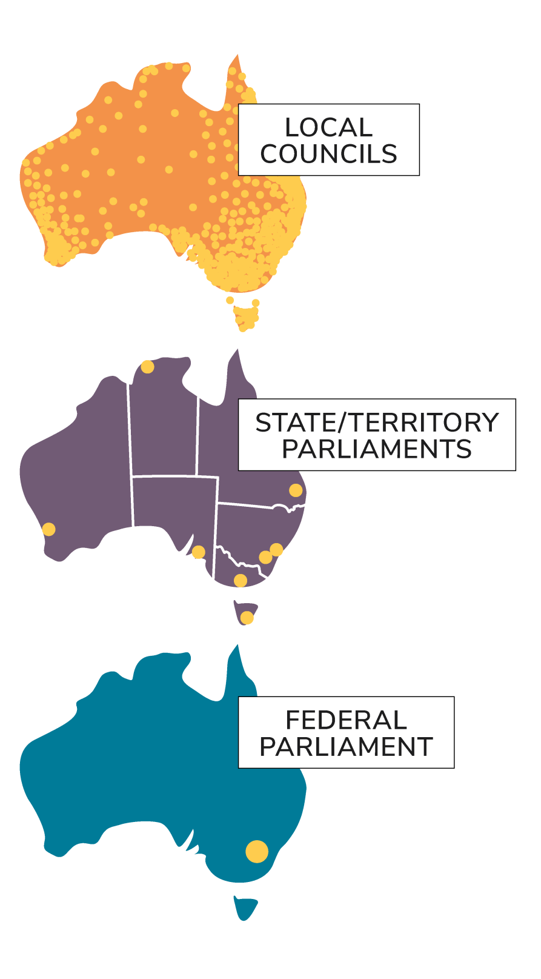
Why three levels?
The division between federal and state government in Australian was an outcome of federation in 1901, when the six British colonies–New South Wales, Western Australia, Queensland, Victoria, South Australia and Tasmania–united to form the Commonwealth of Australia. Up until the 1850s each colony was run by a non-elected governor appointed by the British Parliament.
Under the Constitution the states kept their own parliaments and most of their existing powers but the federal Parliament was given responsibility for areas that affected the whole nation. State parliaments in turn gave councils the task of looking after the particular needs of their local communities.

Slide 38
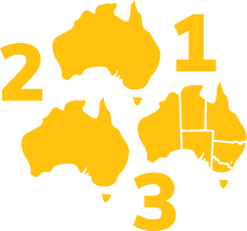
What are the differences between the three levels of government?
Representatives are elected to federal parliament, state/territory parliaments and local councils in separate elections.
Each level of government generally provides different services to Australians which are suited to that level.

Slide 39
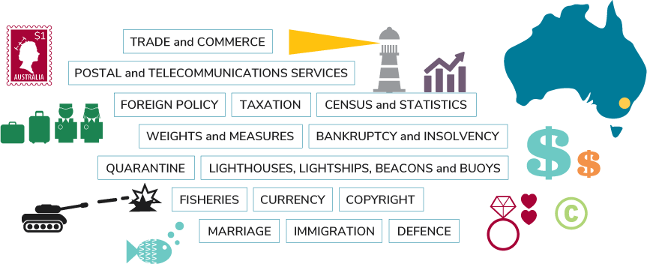
Federal
The federal government administers laws about areas where it may be important for laws to be consistent for all Australia, including defence, immigration, trade and foreign affairs.

Slide 40
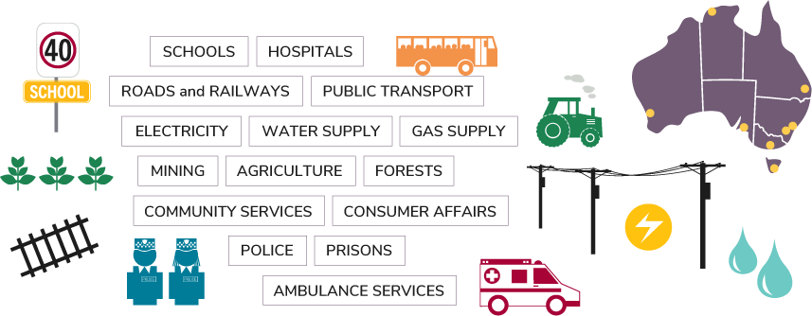
State
State and territory governments make laws about matters not covered by the federal government including hospitals and schools.

Slide 41
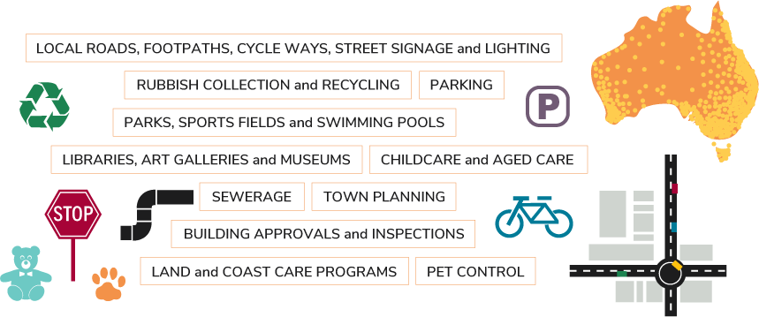
Local
Local councils make by-laws to look after the needs of a local community such as town planning, pet control and rubbish.

Slide 42
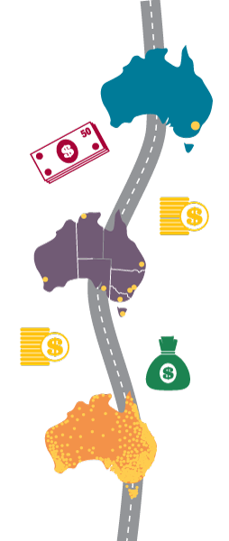
Sometimes responsibilities overlap. For example, local roads are provided through the cooperation of federal, state/territory and local governments. Each one contributes money towards building and maintaining roads.
Under section 109 of the Constitution, if a state Parliament and the federal Parliament pass conflicting laws on the same matter, then the federal law overrides the state law.

Slide 43
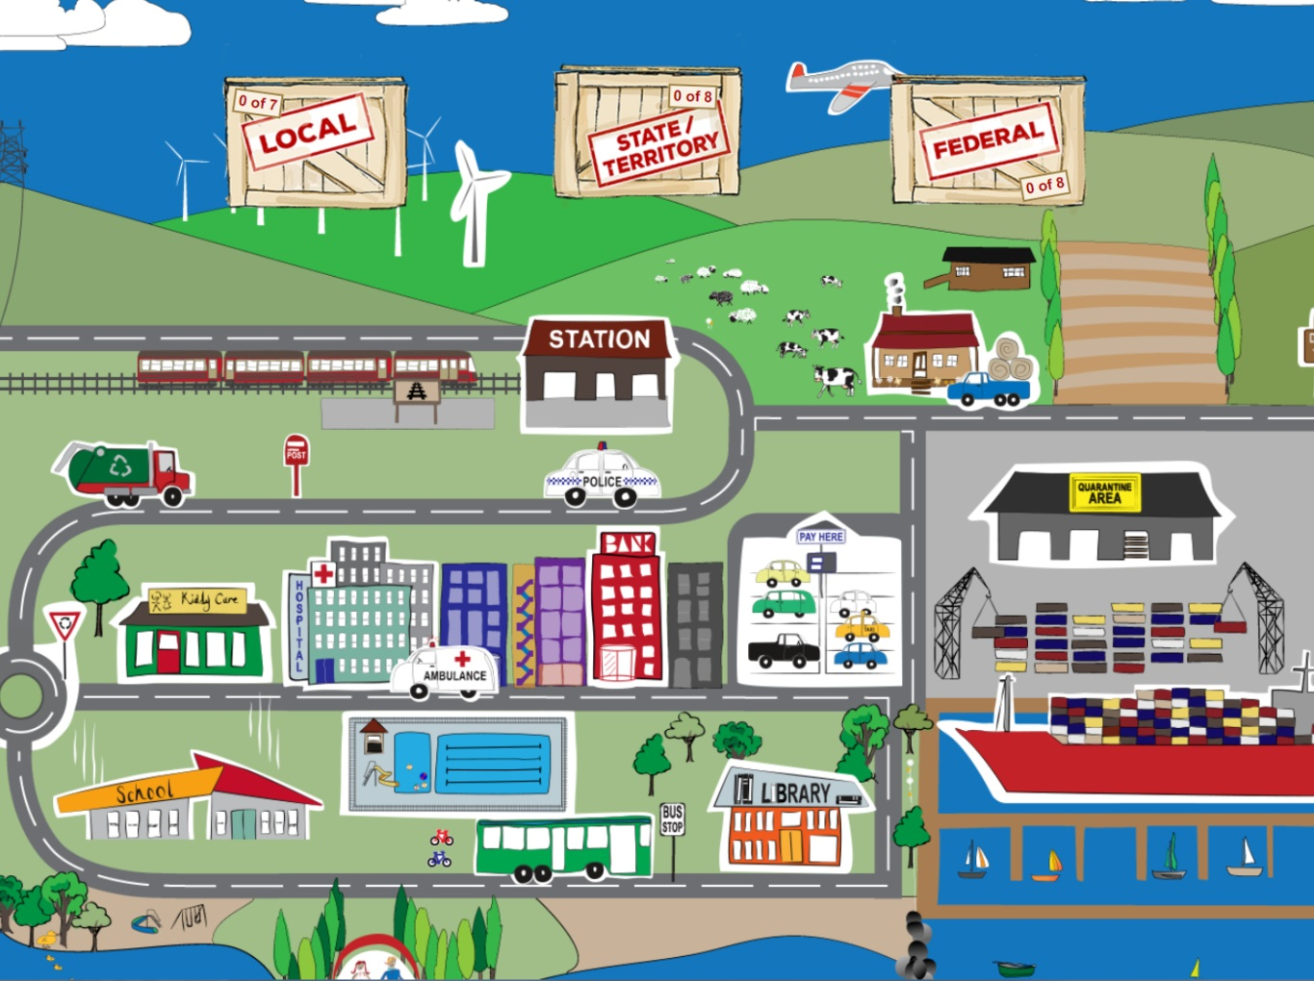
CLASS ACTIVITIES
Play the Federal, State, Local game on the PEO website.
Examine the roles of the three levels of government and brainstorm the skills and qualities of a good federal representative, state representative and local representative. Are there differences between our expectations for representatives from the three levels of government?

Slide 44
Additional resources
PEO resources
Fact sheet – The roles and responsibilities of the three levels of government
In focus – Three levels of government: governing Australia
Unit of work – Year 6
Other resources
Behind the News – Levels of Government

Slide 45
Thank you for completing these modules
Please complete our survey

