Slide 1

Teacher Professional Learning
OUR PEOPLE

Slide 2

MODULE 5
Elections

Slide 3
In this module you will learn that:
Free, fair and franchised elections are a vital part of Australia’s democracy.
Voting is both a right and a responsibility.

Slide 4
Focus questions
What are the rights and responsibilities of citizens in Australia's democracy?
How do elections work and why are they important?
Preferential voting – video

Slide 5
Elections in Australia
Australia is a representative democracy which means that Australians elect members of parliament to make laws and decisions on their behalf.
At a federal election, Australians elect members of parliament to represent them in federal Parliament.
Enrolling to vote and voting are both compulsory.
The federal Parliament is bicameral which means that it consists of two houses—the Senate and the House of Representatives.
Under section 28 of the Constitution, members of the House of Representatives are elected for a maximum term of three years, although elections may be called earlier.
When an election for the House of Representatives is called, a half-Senate election is usually held at the same time. Newly-elected state senators begin their term of office on 1 July following such an election.
However, in a double dissolution election, both the Senate and the House of Representatives are dismissed (dissolved), meaning every seat in both chambers is contested. This type of election is held to resolve disagreements between the House and Senate.

Slide 6

House of Representatives
There are 151 members in the House of Representatives. Each member represents an electorate in Australia. Electorates are based on population—on average, 107 000 voters live in each electorate. This means that states with larger populations have more electorates and therefore more members in the House.
Elections for the House of Representatives use a preferential voting system to elect one member for each electorate. A candidate must get an absolute majority (more than 50% of the votes) to be elected.
Voters write a number beside the name of every candidate on the ballot paper: '1' for their first preference (or choice), '2' for their second preference and so on.
151
electorates
= 151
members in
the House of
Representatives

Slide 7
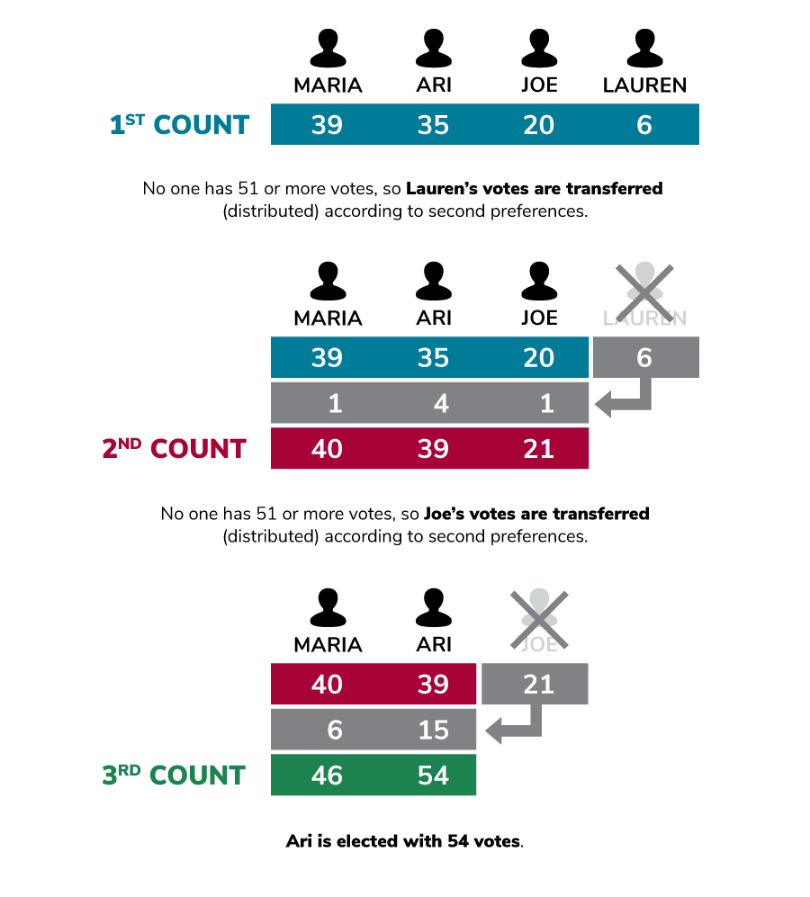
If a candidate gets an absolute majority of first preference votes, that candidate wins. If no candidate has enough first preference votes for an absolute majority, then the candidate with the fewest votes is excluded and their votes are transferred to the remaining candidates, according to voters' second preferences.
This process of excluding candidates and redistributing votes continues until one candidate achieves an absolute majority.

Slide 8

Senate
The Senate has 76 senators. Each Australian state is represented by 12 senators. The states were given equal representation in the Senate so that states with larger populations did not dominate the Parliament. Since 1975, the Australian Capital Territory and the Northern Territory have each been represented by two senators.
In Senate elections, Australians are voting to fill more than one vacancy. Elections for the Senate use a preferential voting system known as proportional representation. This means senators must get a ‘quota' (set number) of votes.
6
states
2
territories
= 76
senators in
the Senate

Slide 9
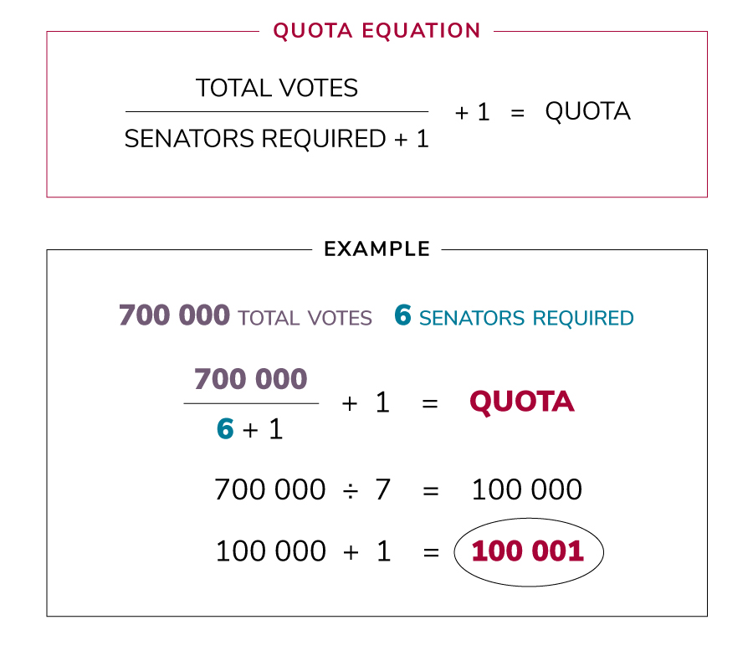
The number of votes required is obtained by dividing the total number of votes (in each state or territory) by one more than the number of candidates and then adding one to the result.
A wider range of independents and smaller parties are often elected to the Senate as it is easier for them to achieve a quota of votes from a state rather than 50% of votes from an electorate.

Slide 10
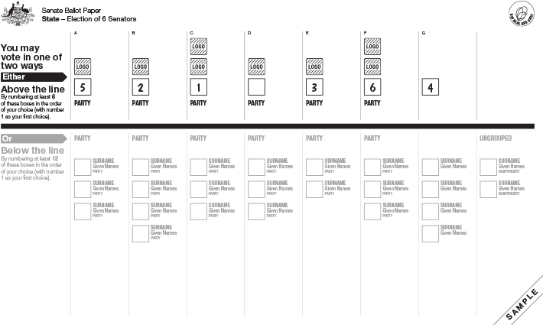
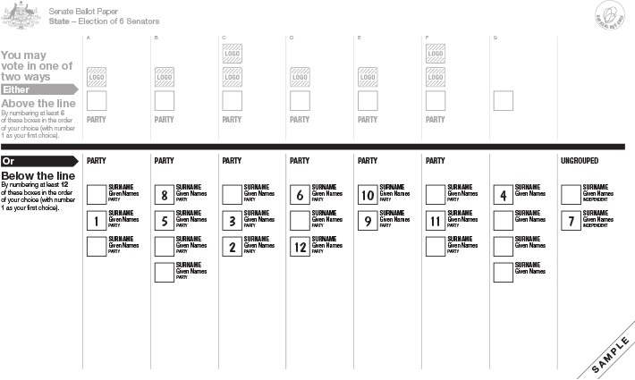
Senate ballot papers list all the names of the candidates and the political parties to which they belong, followed by ungrouped or individual candidates. Senate ballot papers are divided into two sections to give people a choice of voting 'above-the-line' or 'below-the-line'.
  Above-the-line voting means that voters have to number at least six boxes from 1 to 6 for their chosen parties or groups. Voters' preferences will be distributed in the order that the candidates in the chosen parties or groups are listed below the line. Preferences will be distributed to the party or group of first choice, then second choice and so on, until all preferences are distributed.
  Below-the-line voting requires voters to number at least 12 boxes from 1 to 12 for their chosen individual candidates. Voters' preferences will be distributed to the candidates in the order of choice, as numbered on the ballot paper.
State senators are elected for a period of six years. The Senate is elected on a rotating basis, with half the state senators elected every three years. The terms of territory senators are the same as the members of the House of Representatives.

Slide 11
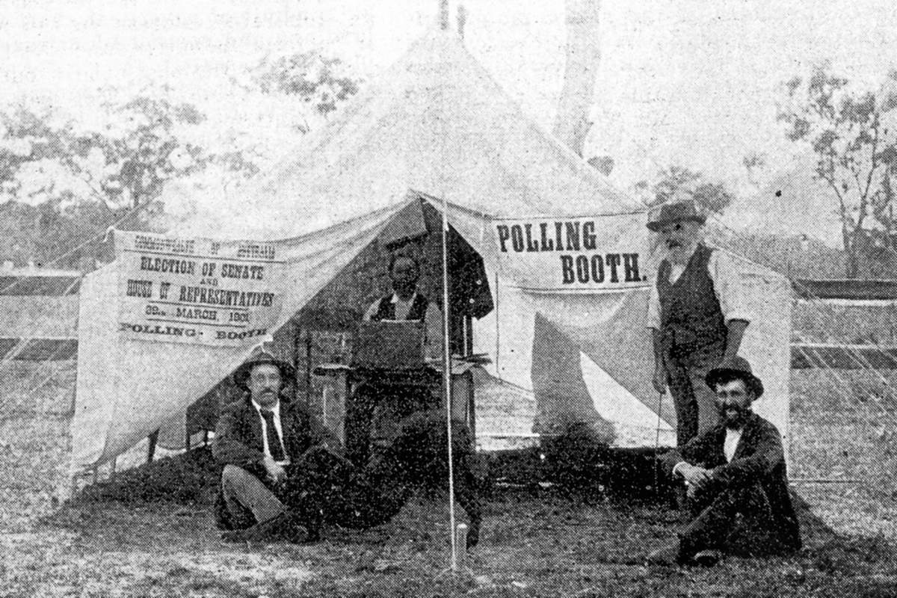
The history of enfranchisement in Australia
At the very first federal election, held in March 1901, people who could vote in their state elections were allowed to vote for the first federal Parliament. After that, it was up to the Parliament to make laws about how elections were conducted, including who could vote.
In some states, Indigenous Australians, as well as women, had the right to vote. This meant they could take part in the 1901 election. However, not many Indigenous people were aware they had this right.
In 1902 the Parliament passed the Commonwealth Franchise Act 1902. This gave women the vote, but excluded 'any aboriginal native of Australia, Asia, Africa, or the islands of the Pacific, except New Zealand' from voting unless they were on the electoral roll before 1901.
In 1924 it became compulsory for eligible voters to vote in federal elections.

Slide 12
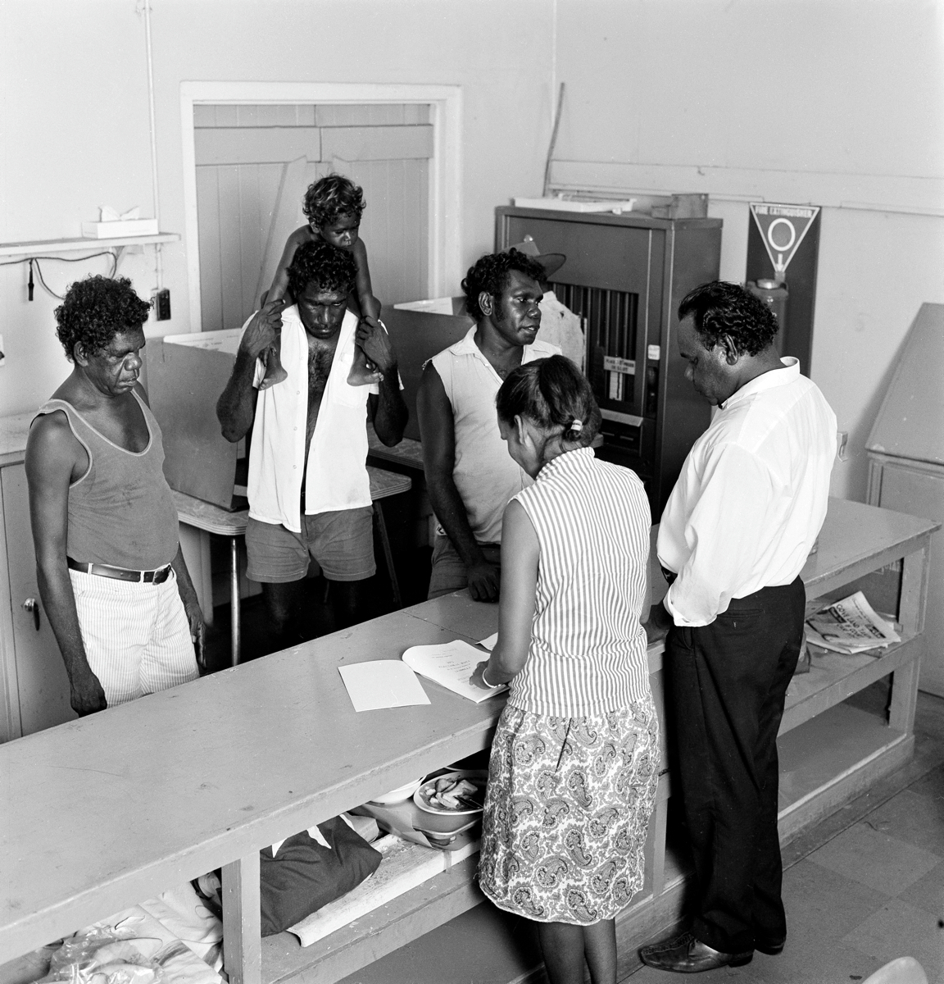
In 1949, federal Parliament amended, or changed, the Commonwealth Electoral Act to give Indigenous people who had completed military service, or who already had the right to vote in their state, the right to vote in federal elections.
In 1962 the Parliament amended the Commonwealth Electoral Act to extend the right to vote to all Indigenous Australians. However, unlike other Australians, Indigenous people did not have to vote. Voting was only compulsory for those who enrolled to vote.
Aboriginal and Torres Strait Islander peoples were finally given equal voting rights in 1983 when the Commonwealth Electoral Act was amended to make it compulsory for all Indigenous Australians to vote.
In 1973 the voting age was lowered from 21 to 18 in response to changing demographics and Australia’s involvement in the Vietnam War.

Slide 13

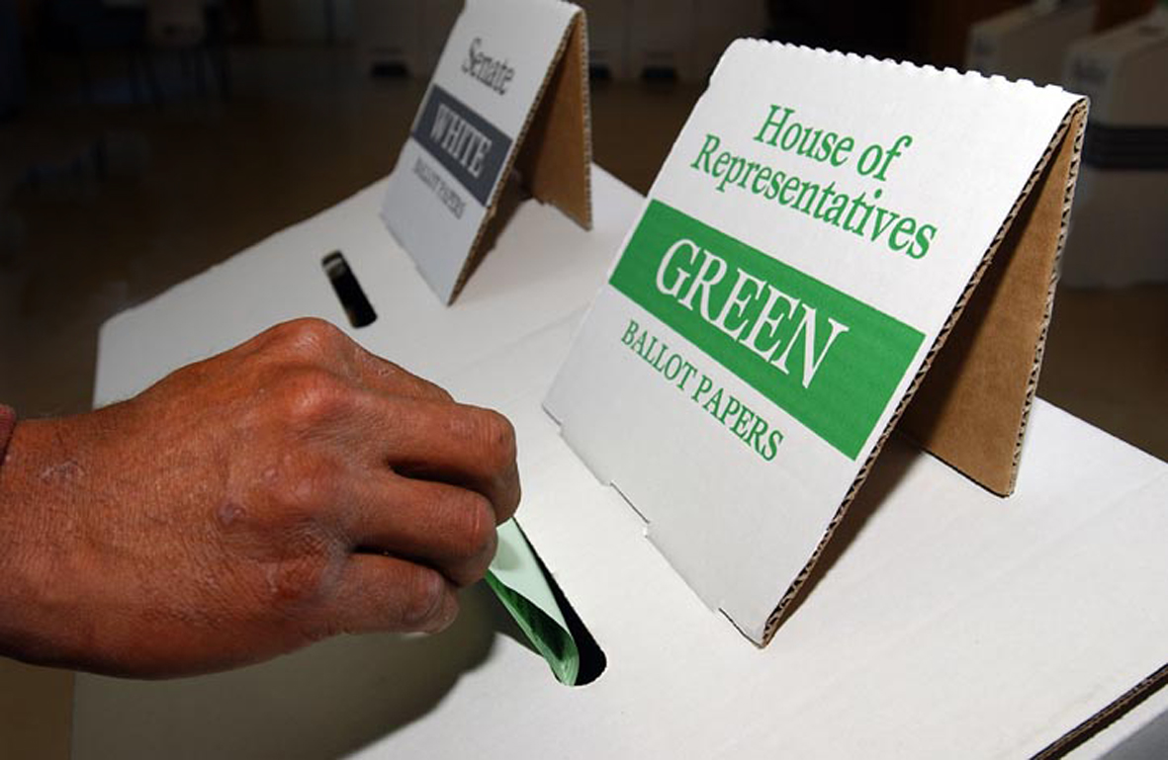
CLASSROOM ACTIVITIES
Try creating some posts for your own social media campaign
Take the Federal elections quiz

Slide 14

Food for thought
What influences the way you vote? Where can you find information to help you make an informed decision?
Should voting be compulsory in Australia?
Should the voting age be changed?
Does our vote count?

Slide 15

Additional resources
PEO resources
Fact sheet – Federal elections
Website – Federal Parliament History Timeline
Australian Electoral Commission
Get Voting

Slide 16
MODULE 6
Representation

Slide 17
In this module you will learn that:
The concept of representation is fundamental to Australia’s democracy and involves an active relationship between the people and their elected representatives.

Slide 18
Focus questions
What does representation mean?
In what ways is the federal Parliament representative?
What makes a good representative?
Frontbenchers and backbenchers

Slide 19

What is representation?
Representation is the act of speaking/acting on behalf of others.
The Australian people are responsible for electing members of all three levels of government.

Slide 20
Representation in the Federal Parliament
Federal Parliament represents all Australians. It is the job of each member of parliament to speak for, and vote on behalf of, their constituents. For members of the House of Representatives, constituents are the people who live in their electorate. For senators, it is the people in their state or territory.
Members of parliament represent their constituents in a number of different ways. For example, they might argue for or against a bill (proposed law), or make statements and ask questions in the Parliament or investigate matters in a parliamentary committee. They can speak to ministers and government departments about issues affecting their constituents and ask them to take action to solve problems.
Members of parliament also represent Australians by making decisions on their behalf. Decisions are made in Parliament by voting on bills and proposals put forward by ministers and other members of parliament.
Members of parliament can speak freely for the people they represent in the Parliament because they are protected by parliamentary privilege. This means that legal action can't be taken against them for anything they say or do in Parliament. This freedom allows the Parliament to debate and inquire into any matters in a detailed and open way.
The Governor-General is not elected by the Australian people, so is not the people’s representative. The Governor-General represents the King, our head of state.

Slide 21
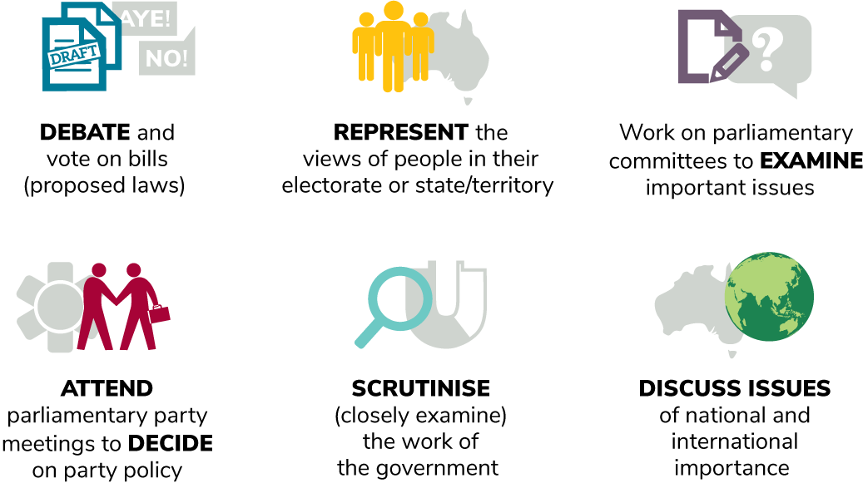
What members of federal parliament do

Slide 22
CLASSROOM ACTIVITIES
Build your own electorate
Select a location and name for your electorate
Establish the demographics of your electorate
Brainstorm a list of relevant issues for your electorate
Example
The electorate of Sarah in north-west Tasmania
Apple farmers, young families, tourism workers
Schools and universities, internet speeds, employment for young people

Slide 23
Additional resources
PEO resources
Fact sheet – Federal election
Fact sheet – Getting involved in Parliament
Video – What is Parliament?
Classroom activity – Run an election campaign
Classroom activity – Explore decision making
Unit of work – Year 5
Unit of work – Year 7

Slide 24
MODULE 7
Rights and responsibilities
of citizens

Slide 25
In this module you will learn that:
Australia’s democratic system of government provides many rights and freedoms for citizens.
Australia’s system of government works best when Australian citizens are involved in their democratic system.
Australians who actively engage with their democratic system have a range of choices and opportunities in how they choose to have their say and participate in change.

Slide 26


Focus questions
What rights do Australians have?
Where do these rights come from?
Could they be taken away?
What responsibilities do Australians have
as citizens in a democracy?
If people fail in their responsibilities, what is the result for the country?
What can Australians do to bring about changes in Australian society?
Resource
Get involved – video

Slide 27

Rights
Many of the rights which Australians enjoy come from laws made by the Parliament.
Other rights are provided through common—court-made—law. However, common law can be overruled by laws made by Parliament—statute law.
The Constitution of Australia is not a bill of rights and does not contain many guaranteed rights or freedoms.
The Australian Constitution does contain:
  The right to a trial by jury for a serious federal offence
  The restriction on the Commonwealth that it cannot make a law to prohibit the free observance of any religion or to impose any religious test or observance
  The right to challenge some decisions of the Government in the High Court.
There are other rights for Australians which are not expressly stated, but have been interpreted as being implied by the Constitution. These include the right to freedom of political communication.

Slide 28
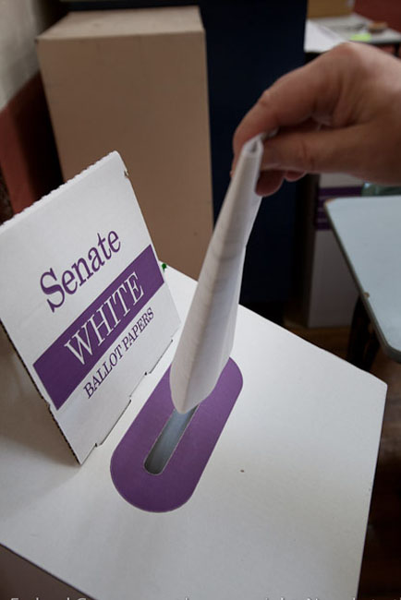
Voting
At least every three years, Australians vote to elect people to represent them in the Parliament.
This is the most direct way that Australians are involved in their Parliament. If the people of Australia do not like the actions of a government, they have a chance to elect new representatives in both the Senate and House of Representatives.
Australians can enrol to vote once they turn 16, although they can't vote until they turn 18.
With the right to vote comes the responsibility to make an informed decision. Citizens can do that by learning about Parliament and taking an interest in candidates, including current representatives in Parliament.

Slide 29
Engaging with Parliament
Australians can watch Parliament in person, online or on TV. Australians can also read the public records of all parliamentary proceedings in the Hansard record. In this way the Australian people can directly scrutinise the Parliament and individual parliamentarians. (See Scrutiny module)
Australian citizens have the right to contact members of parliament. The APH website makes it easy for citizens to search for their elected representatives and the channels through which those representatives can be contacted.
Australians can engage in the committee process. (See Scrutiny module)
Australian citizens also have the right to submit petitions to the Parliament. A petition is a request by a group of citizens for Parliament to take action to solve a particular problem. After a petition has been presented to Parliament, the text of the petition and number of signatures is printed in Hansard. A petition may be forwarded to the minister responsible for the matter raised in the petition for further consideration. However, petitions do not have to be tabled in the Parliament and many citizens may choose to direct their petitions to the representative(s) of their choice.

Slide 30
Citizens’ responsibilities
In a democracy the extent of citizens’ engagement with the governance of the country affects the quality of the country’s governance and the performance of the elected representatives.
Australian citizens can directly engage with the Parliament and their elected representatives by:
  Preparing for elections by understanding the work of the Parliament and the differences between the candidates for whom they can vote
  Scrutinising members of parliament and the work of the Parliament
  Contacting members of parliament to indicate support or opposition to their actions, and to indicate other issues/problems that they should address.

Slide 31
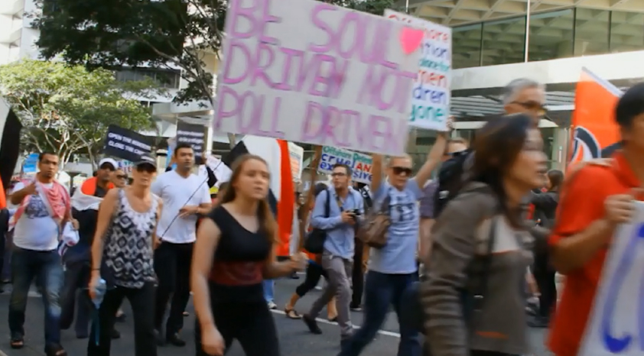
Active citizenship
In a democracy the responsibility of ensuring that the society is well governed rests with the people.
The wide range of freedoms that Australian citizens enjoy creates a variety of means for the people to participate in democracy and affect change in society. As well as those listed above, opportunities for active citizenship also include:
  Expressing political/social opinions in relevant forums and media
  Protests/demonstrations
  Boycotts
  Strike action
  Joining a political party/community group/action group
  Lobbying

Slide 32
CLASSROOM ACTIVITIES
Questions
Who is responsible for Australia’s democracy? How are they responsible?
Can you think of ways to make our country more democratic?
Is violence ever justifiable? Can you think of an example where violence was needed to protect rights?
Brainstorm a list of rights you think are important in your school or community. Are some more important than others?
What’s more important – majority rule or individual rights? Why?
What is the biggest threat to democracy?
When have laws or rules kept you safe or protected your rights?
Affinity mapping
Brainstorm a list of responses to the questions. Use post-it notes to arrange them in different categories.
Scale your responses from most important to least important.
Group your responses according to the four key values of Australian democracy: active and engaged citizens, an inclusive and equitable society, free and franchised elections, and the rule of law.

Slide 33
Additional resources
PEO resources
Website – Federal Parliament History Timeline
Other resources
Australian Parliament House
– Senators and Members page
Australian Electoral Commission
– Find my electoral division

Slide 34
Thank you for completing these modules
Please complete our survey

