Slide 1

Teacher Professional Learning
OUR PARLIAMENT

Slide 2

MODULE 8
Formation of government

Slide 3
In this module you will learn that:
In Australia the party with the support of the majority of members of the House of Representatives can form government.

Slide 4
Focus questions
How does a political party get to form government in Australia?
What is the role of the Australian government?
House of Representatives – video

Slide 5

Formation of government
In Australia, the federal government is part of the federal Parliament. At an election, the party (or coalition of parties) with the support of the majority of members elected to the House of Representatives becomes the government. Although government is formed in the House of Representatives, there are also members of the government in the Senate. The government may or may not hold the majority of seats in the Senate, but usually doesn’t.
The government is responsible for making decisions about how the country is run, including setting a policy agenda, proposing new laws and putting laws into action. In this way, it plays an important role in shaping society and making sure that Australians have the services and safeguards they need.

Slide 6





Government responsibilities
The responsibilities of the federal government include:
developing national policy; for example, plans for managing trade, foreign affairs, immigration and the environment
introducing bills—ideas for new laws or changes to existing ones—into Parliament
putting laws into action, through government departments
making important decisions on behalf of Australians, such as whether or not to send Australian troops to war zones
representing Australia overseas, through key spokespeople such as the Prime Minister and the Minister for Foreign Affairs.

Slide 7
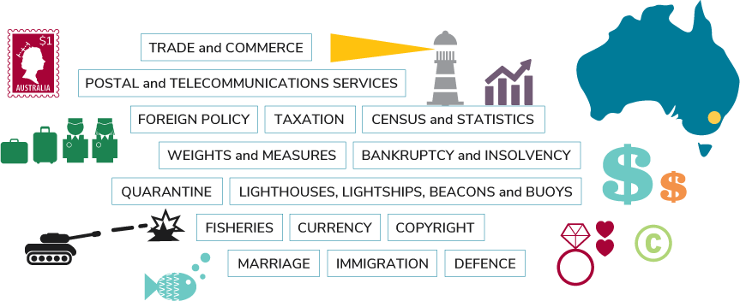
Responsibilities of the federal government

Slide 8
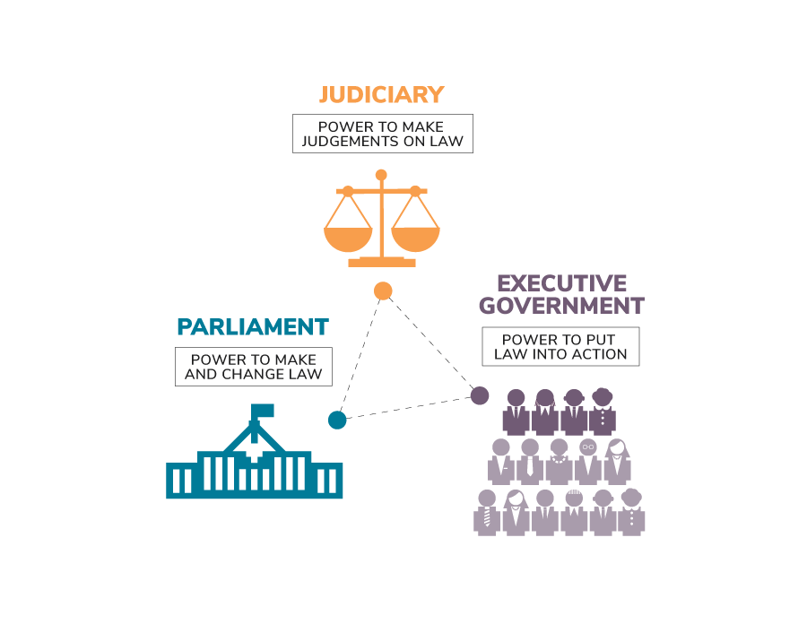
Separation of powers
The separation of powers is the principle that the power to govern should be distributed between the Parliament that makes the law, the Executive that puts the law into action and the Judiciary that interprets the law, to avoid one group having all the power, and to act as a check on the possible misuse of power.

Slide 9
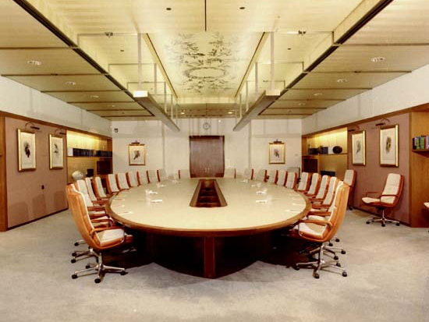
The role of the executive
The Prime Minister and ministers, who are appointed from the government party or parties, make up a group called the ‘executive government’. The executive is mainly responsible for making decisions about how the country should be run and for carrying out laws made by the Australian Parliament.
Cabinet is a group within the executive government consisting of the Prime Minister and top-level ministers, and is the main decision-making group within the executive.
CABINET MEETING ROOM AT AUSTRALIA’S PARLIAMENT HOUSE

Slide 10
The Cabinet is made up of no more than 30 top-level ministers, including the Prime Minister. It usually meets weekly and the meetings generally last for a few hours. The Cabinet is the main decision-making group within the government. Cabinet's role is to direct government policy and make decisions about national issues, including which government bills—proposed laws—should be introduced in Parliament.
Ministers receive a higher salary than other members of parliament because of their additional responsibilities. Federal ministers are allocated an area of responsibility for how Australia is run. This area of responsibility is known as a portfolio. Some examples of federal ministerial portfolios include health, environment, education, defence and immigration.
If a minister needs to introduce a new law or change an existing one, they must first get the approval of the Cabinet. The minister then works with their government department to prepare the bill before it is considered by the Parliament. If the bill is passed, the minister and their department are then responsible for implementing or putting this law into action.

Slide 11

Responsible government
To remain in government, a party or coalition must maintain the support of the majority of members in the House of Representatives. This is part of the principle of responsible government. It ensures that the government is accountable to the Parliament. In Australia, the principle of responsible government works together with the principle of the separation of powers to guide the way in which law is made and managed (see Separation of Powers: Parliament, Executive and Judiciary).

Slide 12
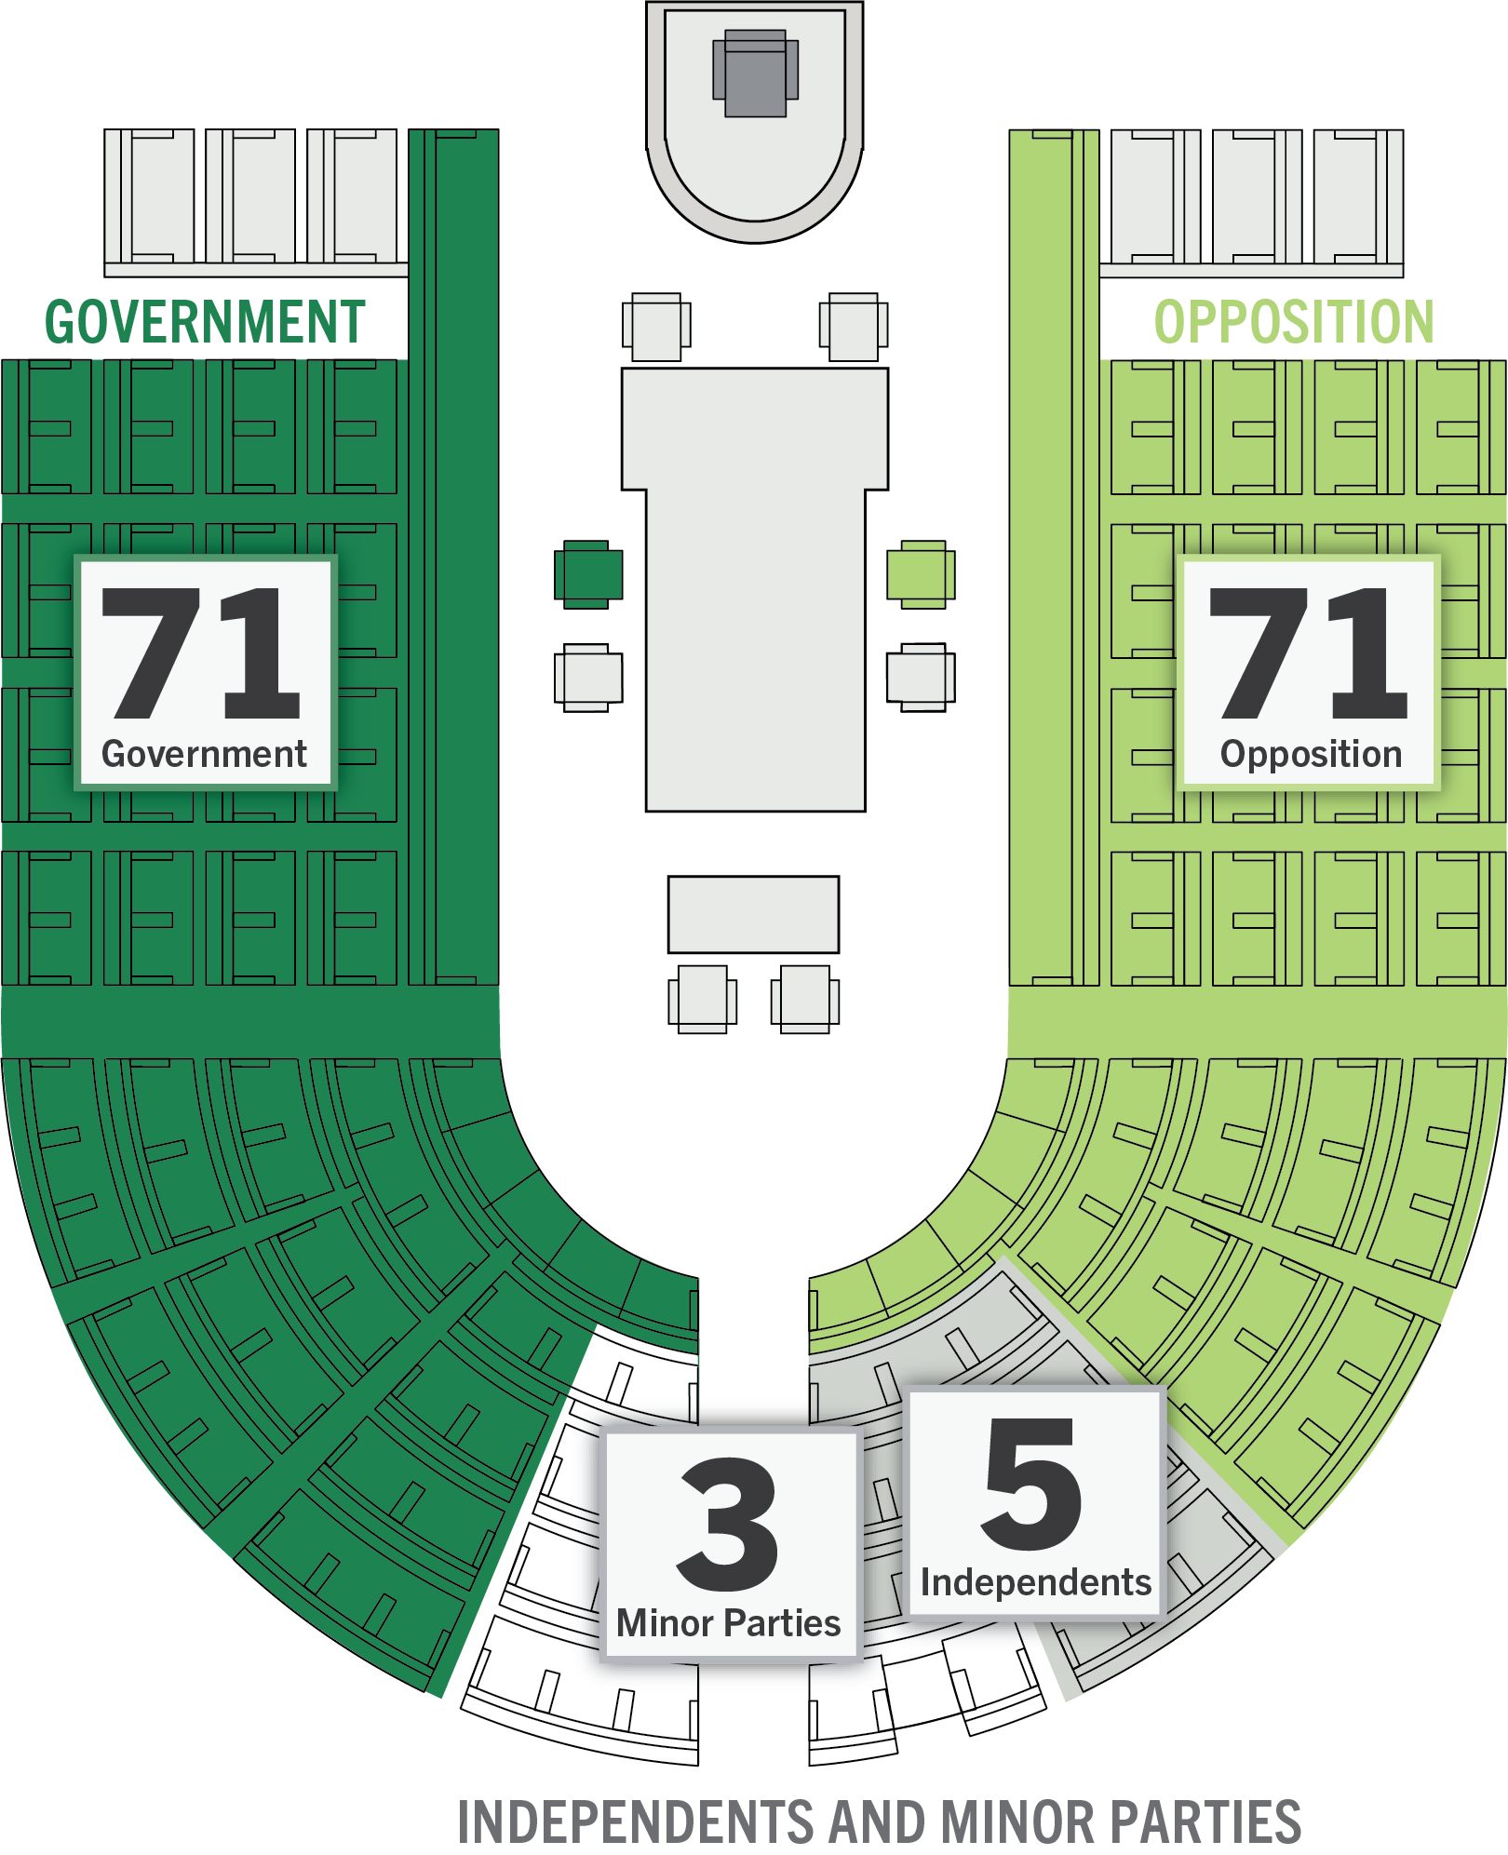
Hung parliament and minority government
MINORITY GOVERNMENT IN THE 43RD PARLIAMENT
If no political party or coalition achieves a majority in the House of Representatives, the result is called a hung parliament. It is still possible for a government to be formed if a majority can be achieved through agreement with independent and/or minor party members. This type of government is known as a minority government.
However, if the independent/minor party members withdraw their support and the government loses its majority it will cease to be able to govern.
The number of members supporting the government can be tested in the House of Representatives if a vote of no confidence in the government is called.

Slide 13

CLASS ACTIVITY
Create political parties
Take 10 minutes to decide who your party is and what your party platform should be.
Answer these questions:
  What is your party’s full name?
  Who is your party leader?
  What are your party’s main beliefs? (party platform)
  What are three policies—plans of action—which your party would like to implement? (party policies)

Slide 14

Additional resources
PEO resources
Fact sheet - Government
Fact sheet – Separation of Powers
Fact sheet – Australian system of government
Other resources
House of Representatives – The Australian System of Government

Slide 15
MODULE 9
Parties and independents

Slide 16
In this module you will learn that:
Most members of parliament belong to a political party.
Political parties help shape our Parliament.

Slide 17
Focus questions
What is the role of political parties in our society and our Parliament?
How is an independent different from a member of a political party?
Political parties
Independents

Slide 18

Political parties
A political party is an organisation that represents a particular group of people or set of ideas. It aims to have members elected to Parliament so their ideas can affect the way Australia is governed.
Political parties often have branches located around Australia. Party members in each branch suggest ideas for party policies. They help choose, or preselect, party candidates for local, state and federal elections. They also assist with election campaigns, distribute 'how to vote' cards on Election Day, and help scrutinise the counting of votes.
Before a political party can enter a candidate in an election, it must officially register with the Australian Electoral Commission. It also has to meet certain regulations under the Electoral Act, such as having a written constitution and at least 1500 members who are eligible to be on the electoral roll or have at least one member of the party who is a Senator or Member of the House of Representatives.

Slide 19
Parliamentary parties
A political party becomes a parliamentary party when it has party members elected to a parliament at the federal, state or territory level.
Parliamentary parties are powerful because their members work as a team and generally vote the same way on issues before the parliament.
During sitting weeks, each parliamentary party has a party meeting which is held in their party room.
The main purpose of party meetings is to decide how the party will work as a team in the Parliament. In party meetings, members of parliament may:
  elect office-holders such as the party leader, ministers and the whips (team managers)
  debate and make decisions about party policy
  discuss tactics and organise party members to speak on particular bills
  resolve potential conflict and differences of opinion to ensure party unity.
Party meetings are only for party members and are confidential.

Slide 20


Coalitions
A coalition is formed when two or more political parties join together. In a parliament, parties may form a coalition to create a bigger group and gain more power.
In the federal Parliament, parties that form a coalition sit next to each other in the House of Representatives and Senate. They generally vote the same way, although they may have different ideas on particular bills—proposed laws. Each party in a coalition usually holds separate party meetings.
A coalition that forms federal government may choose several ways of working together. For example:
  the Prime Minister is usually drawn from the larger party
  the Deputy Prime Minister is usually drawn from the smaller party
  ministries may be shared between the two parties according to the ratio of seats held by the two parties.
The Liberal Party of Australia and the
Nationals have formed the longest-running
coalition in the federal Parliament.

Slide 21






Minor parties
Minor parties only have a small number of members elected to Parliament. They may form part of the government or the opposition through a coalition or agreement with another party. If this is not the case, they sit with the independents on the seats that curve around at the end of each chamber. These seats are commonly called crossbenches.
Sometimes minor parties can hold the balance of power. This means that their vote may decide the outcome of an issue if the government and opposition disagree.

Slide 22


Independents
An independent is a member of parliament who does not belong to a political party. They can be elected to either the House of Representatives or the Senate.
As well as taking part in debate on government bills presented to the Parliament, an independent can introduce their own bills. These are called private members' or private senators' bills. Introducing a private bill enables an independent to suggest a new law on an issue that they think is important that the Parliament is not addressing. Since private bills cannot pass without the support of the majority, they are usually defeated.
Independents usually sit on the seats that curve around at the end of the chamber. These seats are commonly called crossbenches.

Slide 23

Food for thought
Think of some issues that are important in your community. How might these issues be approached by a conservative party, a progressive party and an independent?
How do Australians make political choices? Why might someone vote for a particular party or independent?
What is the role of the crossbench in Parliament?

Slide 24
Additional resources
PEO resources
Fact sheet – Independents
Fact sheet – Political parties
Other resources
Australian Electoral Commission – Current register of political parties

Slide 25
MODULE 10
Law making

Slide 26
In this module you will learn that:
One of the key principles of Australia’s democracy is the rule of law.
One of the key functions of the Australian Parliament is to make laws.

Slide 27
Focus questions
Why do we need laws?
Where do ideas for new laws come from?
How does a bill become a law?
Making a law – video

Slide 28
Ideas for new laws
A proposal for a new law is called a 'bill'.
The government needs to make laws to implement its policies, and to spend/appropriate money.
Government departments make many suggestions for bills. A department may advise its minister about a specific problem that exists. The minister may then arrange for a bill to be drafted to address the problem.
Community groups, businesses or lobby groups may be interested in changing or improving a specific area of Australian law. They can approach members of parliament with suggestions for bills.
Political parties have their own policy ideas about how Australia should be governed. In Parliament, parties introduce bills which aim to put their policies into action.
Sometimes the Parliament sets up a parliamentary committee, or asks an existing committee, to examine a current issue. If the issue requires action, the committee may suggest that a bill is introduced.

Slide 29

Law making in the Australian Parliament
Laws are rules that help manage our society.
One of the main roles of the Parliament is to consider and make new laws and change existing ones.
Some laws tell us how to play our part as responsible citizens, for example laws about voting and taxation. Other laws are made to look after people, such as laws providing money for health or education. Laws are often made in response to an issue, such as tackling cyberbullying.
The law making powers of the Australian Parliament are listed in section 51 of the Australian Constitution.

Slide 30
Introducing bills
Most bills are introduced into the Parliament by the government, although any member of parliament can propose a bill.
Government bills are usually introduced by the responsible minister.
Bills introduced by non-government ministers are known as private members' or private senators' bills.
Bills may begin in either the House of Representatives or the Senate, except for some bills that collect and spend taxpayers' money, which must be introduced in the House of Representatives.
The majority of bills begin in the House of Representatives, where most ministers sit.
When a bill is introduced, the Clerk reads the title aloud to the chamber. This is called the first reading, and it signals that the bill is open to debate.

Slide 31

Passing bills
After a bill is introduced into the House of Representatives or Senate, members of that chamber have the opportunity to debate and vote on it.
If it the vote is successful (if a majority of members vote yes) then the Clerk reads the title aloud again. This is called the second reading.
After the second reading, the members or senators may choose to send the bill to a committee (see Scrutiny module) or to introduce and debate amendments—changes—to the bill.
The bill is then voted on a final time and, if successful, read again. This is called the third reading.
Both the House of Representatives and the Senate consider a bill using the three readings process.
A bill becomes a law if it is passed in both the House of Representatives and Senate in identical form—using exactly the same words—and has been assented to—signed—by the Governor- General.
If at any stage a bill is not agreed to when it is being voted on in the House of Representatives or Senate it does not become a law. The government may choose to re-introduce the bill, and if so they may consider whether to change the bill.
MAKING A LAW – VIDEO

Slide 32


Amending bills
After examining a bill in detail, the Senate or the House of Representatives may decide to make amendments—changes—to a bill to improve it.
These amendments are also debated and voted on. Any member of parliament can suggest amendments.
If the government does not have a majority in either chamber, it may have to negotiate with independents, minor parties or the opposition and make amendments to the bill so it will be passed.
Any amendments agreed to in one chamber must also be agreed to in the other chamber, so a bill may be sent back and forth several times.

Slide 33
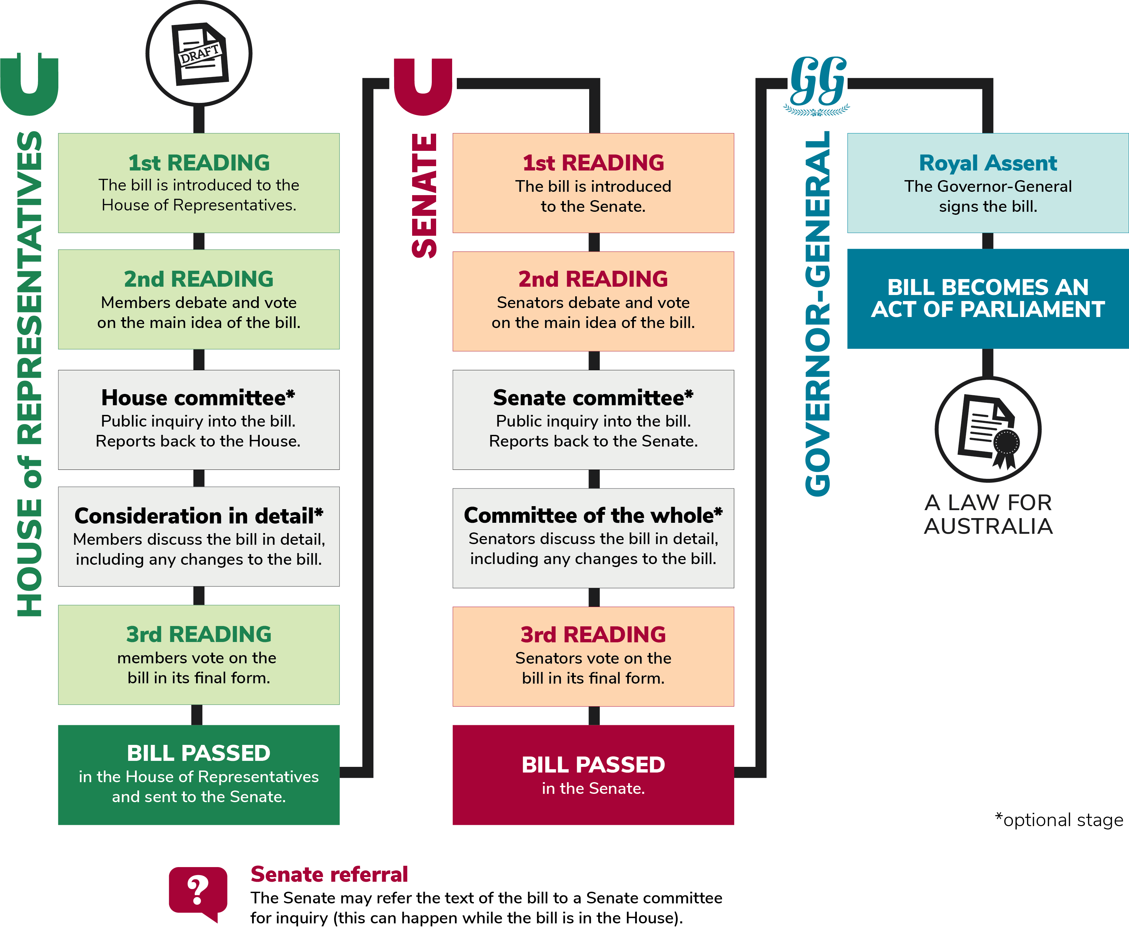

Slide 34
CLASS ACTIVITY
As a member of parliament what law would you make for Australia?
What problem might you solve?
How could you improve the lives of Australians?
What do the people of Australia expect you to do?
What can citizens do if they have an idea for a new law?

Slide 35
Additional resources
PEO resources
Fact sheet – Making a law in the Australian Parliament
Other resources
House of Representatives – Infosheet 7 – Making laws
Senate – Brief 8 – The Senate and legislation
Australian Parliament House – List of current Parliament’s bills and legislation

Slide 36
MODULE 11
Scrutiny

Slide 37
In this module you will learn that:
The government is accountable, or answerable, to the Parliament, which means it is expected to explain what it is doing and why.
The Parliament has a number of ways in which it scrutinises—closely examines—the work of the government.

Slide 38
Focus questions
How does the Parliament hold the government accountable for its actions and decisions?
Which methods of scrutiny are the most effective?
Question time in the Australian Parliament

Slide 39
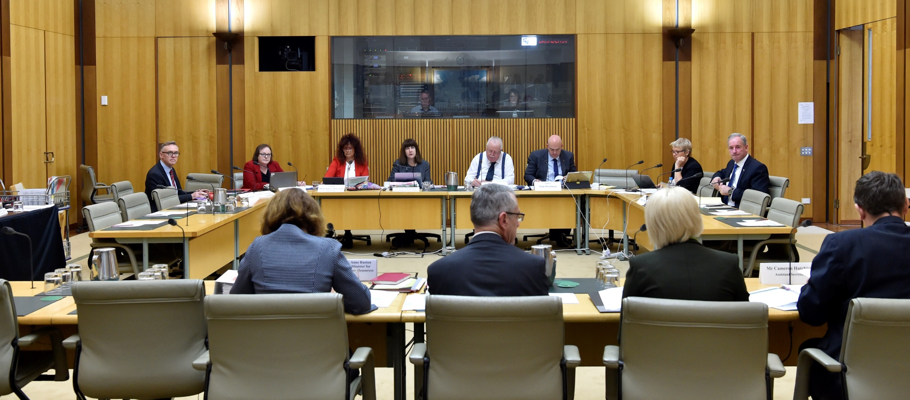
The role of the opposition and the crossbench
It is up to the Parliament, in particular the opposition, minor parties and independents, to hold the government to account.
Much of this public scrutiny happens during Question Time and in Senate estimates hearings.

Slide 40
Committees
Parliamentary committees are set up by the Senate and the House of Representatives to investigate bills—proposed laws—or issues in more detail than is possible in either chamber. This helps the Parliament make better informed decisions.
Most members of parliament, except ministers, serve on committees. A parliamentary committee is usually made up of six to ten government and non-government members of parliament.
The committee invites the public, experts and officials to make written statements outlining their views about the bill or issue. It then might ask some of these people to appear before it to answer questions and provide further information. Once it has collected sufficient evidence the committee writes a formal report which is presented to the Parliament. The report may suggest changes to a bill or make other recommendations.
Through its work, committees can check that the Parliament is making good laws for Australia and is responding to any problems facing the country. It is also one of the ways the Parliament checks that the government is acting in the best interests of the nation.

Slide 41
Senate estimates
Senate estimates hearings, also known as estimates committees or simply ‘estimates’, allow senators to examine how the government has spent taxpayers’ money and its future spending plans.
Each of the eight estimates committees is responsible for examining different government departments and agencies. During the hearings, senators can ask relevant government senators and senior public servants about the work of their department. They may be asked to explain the purpose of the programs and services provided by their department, and how they are run.
Under detailed questioning from non-government senators, ministers and department officials may reveal details about government practice that have not been made public. Estimates hearings may lead to improvements in the way government departments operate. As well, they remind the government that it is accountable to Australians for its policies and actions.
All estimates, and most committee hearings, are open to the media and the public and are broadcast live.

Slide 42
Question Time
During Question Time, the Prime Minister and ministers are asked to explain government decisions and actions. Question Time is scheduled in both the House of Representatives and Senate at 2pm every Monday to Thursday when Parliament is sitting and runs for about one hour.
The opposition, minor parties and independents use Question Time to raise important issues, and to make sure that the decisions made by the government are in the national interest. The opposition may also ask questions aimed at highlighting weaknesses in the government's performance and at presenting itself as an alternative government.
In contrast, members of the government ask ministers questions that give them a chance to explain the benefits of their actions to the country. Question Time also allows ministers to talk about urgent matters and to display their political skills.
Question Time is often the liveliest part of the sitting day. It is broadcast on national television, radio and the internet and is widely reported in the media. This gives the public an opportunity to observe Parliament at work.
QUESTION TIME – VIDEO

Slide 43




Public scrutiny
Members of the public can monitor the work of the Parliament in a number of ways including:
Watching the proceedings of the Parliament in person or online on the APH website
Reading Parliamentary documents such as Hansard, Votes and Proceedings, and Journals of the Senate
Following the work of the Parliament as reported in traditional and social media
Interacting with MPs and senators via community forums, email, mail and social media.

Slide 44
Food for thought
From what you have seen of Question Time is it an effective mechanism for scrutinising the work of the government? (You can watch past QTs on YouTube)
In which other ways can the people of Australia participate in holding the government to account?

Slide 45
CLASS ACTIVITIES
Run a committee inquiry
Review the Run a parliamentary committee classroom activity.
Make a list of cross-curricular topics that you could explore in your classroom using this activity.
Discover current committee inquiries
Review the current committee inquiries on the APH website.
Highlight topics that may be of interest to students and think about how a class could get involved by drafting and sending in a submission.

Slide 46
Additional resources
PEO resources
Fact sheet – Opposition
Fact sheet – Independents
Fact sheet – Senate estimates
Fact sheet – Committees
Fact sheet – Question Time in the Australian Parliament
Other resources
House of Representatives – Infosheet 19 – The House, government and opposition
Senate – Brief 5 – Consideration of Estimates by the Senate’s Legislation Committees
Australian Parliament House – Committees

Slide 47
MODULE 12
The role of the media

Slide 48
In this module you will learn that:
A free press is an important part of a working democracy.

Slide 49
Focus questions
How does the media work to keep citizens informed and to keep the government accountable?
Why is it important to develop critical media literacy skills?
Press gallery

Slide 50


The press gallery
Whilst all media may report on the work of parliament there is a part of Parliament House where media organisations are located called the press gallery. The press gallery is made up of approximately 250 journalists and related staff who work for newspapers, television, radio stations, online news sources, blogs and other organisations that collect and publish information.
The press gallery also describes the area of Parliament House in which journalists work. This includes offices, broadcasting studios and special viewing areas above the Presiding Officer's chair in both the Senate and House of Representatives.
The role of the press gallery and other media is to gather information and publish stories about what happens in federal Parliament. The stories might include items about Question Time, policies and decisions of the government and opposition and particular people such as ministers and shadow ministers.

Slide 51
The press gallery and members of parliament both wish to publicise the work of the Parliament. Members of parliament depend on the media to inform the public about what is happening in the Australian Parliament.
Ministers and shadow ministers may be interviewed on television and radio from the Parliament House studios so that they can explain what they are doing in Parliament.
Members of parliament call press conferences, inviting the press gallery to hear statements and ask questions about a particular issue.
Members may also be interviewed as they enter and leave Parliament House; this is known as a doorstop interview.
As well as providing factual accounts of the work of parliament some media provide commentary or political opinions. Commentary/opinion pieces may be supportive or critical of different parties, and members of parliament.
The media is influential because the journalists and organisations are free to select the news and publish what they think is interesting and important. They decide which members of parliament they will interview and what issues they will publicise.
Journalists have a professional responsibility to find the truth about a subject and to compare information from different sources. In this way, the media exercises an important scrutinising role in the Parliament.

Slide 52
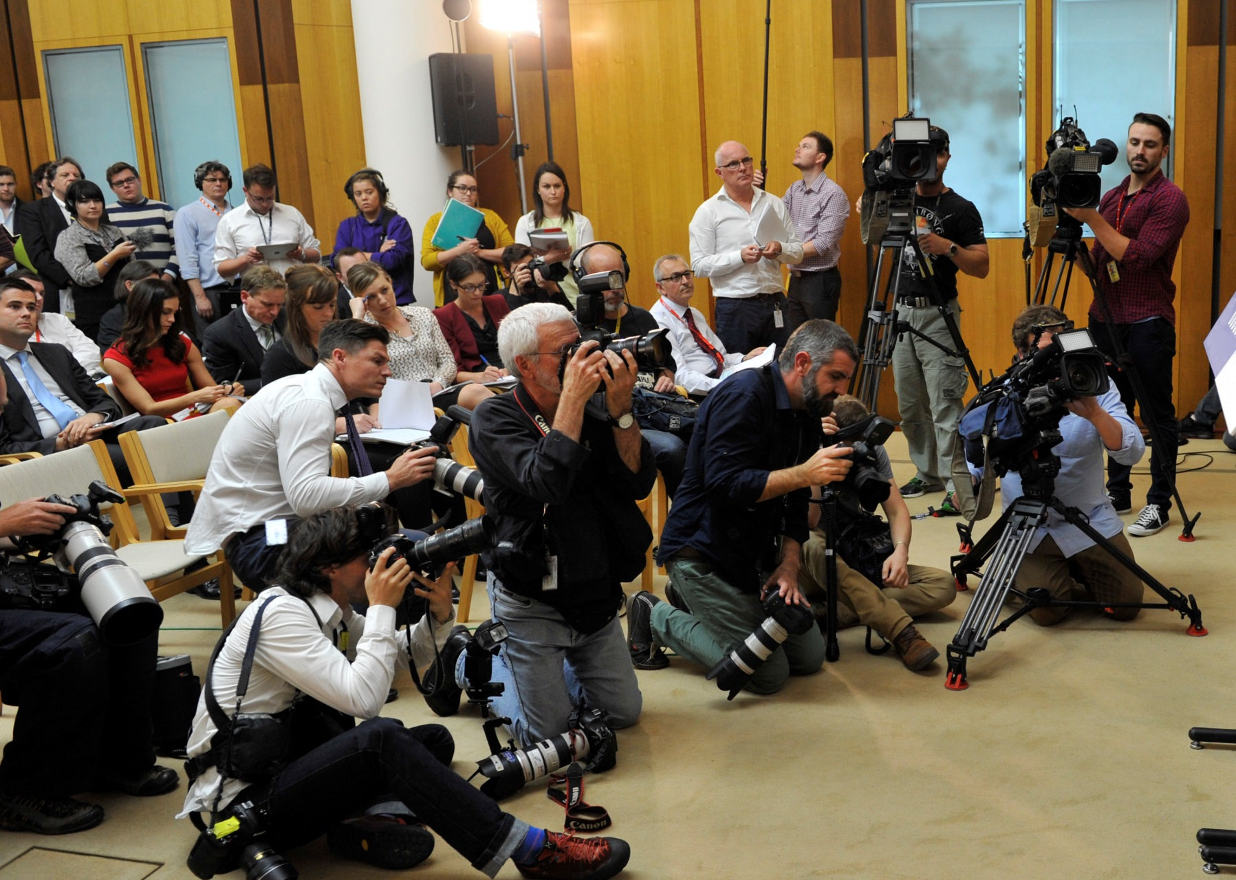
The public relies on the media to scrutinise the Parliament and government and to search out the truth of events and stories. As a result, the media have a lot of influence on public opinion, and members of parliament are careful in the way they work with journalists.
Many members of parliament and political parties use social media to connect with the Australian people. This enables them to provide their own content directly to voters without being subject to the editorial, commercial or professional considerations of mainstream media outlets.

Slide 53
Food for thought
What is the influence of social media on our democracy?
What role does the media (such as TV, radio, newspapers, internet blogs) play in influencing the outcome of elections?
What advice would you give to students to encourage them to become critical consumers of political coverage in mainstream/social media?

Slide 54
CLASS ACTIVITIES
List some policies or messages that a political party might want to convey to voters.
Think about how they might use social media to get their message across.
Which platform might work best for a particular message?
Reflect on the effectiveness of social media as a tool for political messages.
  Who does it reach? Who does it leave out? If there are people it doesn’t reach, how might a candidate or parliamentarian reach those people?
  What are the risks to candidates and parliamentarians when using social media platforms?

Slide 55
Additional resources
PEO resources
Fact sheet – Press gallery
Other resources
Federal Parliamentary Press Gallery – Website
ABC Education – Media literacy

Slide 56
Thank you for completing these modules
Please complete our survey

